Slide 1
TRACKER
Dates | Changes | POC | File Version
Notes:
Service P.O.C.s
Phil Tabor U.S. Army
LT Jacqueline Kyzer, USN
LT Patrick R. Pennella Coast Guard Recruiting
NCCM(SS) Jason Moore Chief Recruiter, Navy
Mark A. Pennock, CMSgt, USAF
William C. Boettcher, MSG, U.S. Army
Jack Jacobs USMC
Andy Carswell NIT EPDS/MEPS Trainer, Navy
MICHAEL MALOTT, MSgt, USAF
Spencer, Scott, ARNG

Slide 2
Facilitator Notes
Print this presentation in “Notes View” to see the content the Facilitator will present.
Add your own notes to the pages as you prepare for your session
Notes:
Facilitator Notes
Your Role
Your role as the Facilitator is to:
Present the content.
Provide examples related to the topic.
Add personal experiences to support content.
Engage the participants by asking open-ended questions to encourage discussion, sharing of ideas, stories, and successes.
Prior to the Session
Print the slide presentation in “notes view” (select Notes Page from Print Layout option) and make sure you are comfortable with the content.
Add any additional notes or directions to the Facilitator column of the slide to help you during the session.
Make sure you are familiar with the slides and topic for any guest speaker that will be joining the session.
The Session
As participants join the session:
Welcome them. You can do this verbally.
Encourage conversation by talking about current events, holidays, weather, weekend activities, etc.
When the session begins:
Present the content for the session’s topic.
Engage the participants by asking them to raise their hand or provide examples.
Ask questions and provide feedback. For example, “what are some other examples…?”, “thanks for sharing” or “that’s a great example.”
Ask participants for their thoughts, ideas, suggestions to a participant’s response or question.
Allow and plan for silence when participants do not respond.
Keep to the time designated for the session.
When the session ends:

Slide 3


Service Liaison / Guidance Counselor
TASKS
Briefer’s Full Name and Rank
Briefer’s Title
2018
Notes:
Topics Presented:
Introduction and Overview
Applicant Record Data Entry
Project Applicants
Opening Procedures
Process Applicants
Ship Applicants
Total Time: XX minutes

Slide 4



INTRODUCTION
Notes:
Time: xx minutes

Slide 5
PURPOSE & OBJECTIVES
Purpose: The purpose of this session is to provide an overview of your tasks as a Service Liaison or Guidance Counselor. In partnership with USMEPCOM, this session is provided as a template to enhance current Service’s guidance on MEPS processes.
Objectives:
At the end of this session, participants will understand:
MDC/A Calculation
Applicant Record Data Entry
Projection Scheduling
Opening Procedures
Aptitude Testing
Medical Processing
Enlistment Processing
Travel Processing
Notes:
Time: xx minutes

Slide 6
Maximum Daily Capacity/Allocation (MDC/A)
MDC/A determines both the MEPS’ maximum daily capacity for new contracts (excluding shippers) and full medical exams (excluding inspects) based on MEPS Human Resources Assistant (HRA) and medical staffing (excluding CMO, Assistant Chief Medical Officer (ACMO), and Fee Basis Provider (FBP).
MDC/A provides each Service a guaranteed minimum level of daily contract/full medical exams.
Service allocation is determined by the MEPS workload percentage each Service executed the previous fiscal year.
Allocation numbers are rounded up to the next full number.
Service allocation will only be used to limit processing when the overall MEPS capacity for contracts or full medical exams is exceeded.
MDC/A numbers established annually are available on SPEAR: J-3/Current Operations Division page, under Operational Guidance MDCA for FY__ : https://spear.mepcom.army.mil/Headquarters/J-3%20MEOP/CurrentOps/SitePages/Home.aspx
Notes:
Time: xx minutes

Slide 7
MDC/A Calculation Examples
Example: Chicago MEPS has 5 medical staff
  Full physical MDC = 25 (5x # of medical staff with exclusions: CMO, ACMO & FBP)
MDC and Minimum Allocation
MDC/A Not Invoked
MDC/A Enforced
 | Full Phys Allocation | Workload Allocation
MEPS MDC | 25
Army | 9 | 35%
ARNG | 4 | 15%
Navy | 5 | 20%
Air Force | 4 | 15%
USMC | 3 | 10%
CG | 1 | 5%
Total | 26 | 100%
 | Full Phys Allocation | Projection Allocation
Army | 9 | 12
ARNG | 4 | 4
Navy | 5 | 3
Air Force | 4 | 2
USMC | 3 | 2
CG | 1 | 0
Total | 26 | 23
 | Full Phys Allocation | Projection Allocation
Army | 9 | 12
ARNG | 4 | 4
Navy | 5 | 7
Air Force | 4 | 4
USMC | 3 | 3
CG | 1 | 1
Total | 26 | 31
This number becomes
MEPS full physical MDC
Even though Army is over its allocation, MEPS full phys MDC of 26 has not been reached, therefore Army is allowed to project for 12
Army & Navy over allocated *and* MEPS full phys MDC has been exceeded - MDC may be enforced to lower projections for Army & Navy
Notes:
Time: xx minutes

Slide 8
REFERENCES
Accession Processing
(Administrative and Enlistment)
USMEPCOM Reg 601-23, Enlistment Processing (Oct 17)
USMEPCOM Reg 680-3, USMIRS (May 06)
Aptitude Processing
DoD Manual 1145.02, Military Entrance Processing Stations (Jul 18)
USMEPCOM Reg 611-1, Enlistment Qualification Tests (Oct 17)
USMEPCOM Reg 601-4, Student Testing Program (Sep 17)
Medical Processing
AR 40-501, Standards of Medical Fitness (Joint Service Reg) (Jun 17)
USMEPCOM Reg 40-1, Medical Processing & Examinations (Jul 17)
USMEPCOM Reg 40-8, DoD HIV and DAT Program (Mar 17)
DoD Directive 1145.02E, USMEPCOM (Oct 12)
DoD Instruction 1304.02, Accession Processing Data Collection Forms (Sep 11)
DoD Directive 1304.12E, Military Personnel Accession Testing Programs (Sep 05)
DoD Instruction 6130.3, Medical Standards for Appointment, Enlistment and Induction into the Military Services (Mar 18)
USMEPCOM Reg 55-2, Transportation and Travel
USMEPCOM Medical Prescreen Program Standard Operating Procedure
USMEPCOM Reg 715-4, Applicant Meals & Lodging Program
DoD Manual 1145.02, Military Entrance Processing Stations (Jul 18)

Slide 9

Applicant Record Data Entry

Slide 10
USMIRS Log-in
The DD Form 2875 System Authorization Access Request (SAAR) to be used is and must be acquired from the MEPS Information Technology Specialist (ITS). Once the DD Form 2875 has been processed, the MEPS ITS will:
  assign each Service User a USMIRS User ID and temporary password
  capture each Service User’s biometric information (fingerprint and facial recognition photo) for e‐Signature purposes
To open USMIRS, enter your MEPS USMIRS URL into the web browser with the MEPS name from the table or, if available, double click your MEPS USMIRS icon. The URL is: https://mirs.rsn.mepcom.army.mil/MEPS/{mepsname}
Enter Password which must be a minimum 10 characters; 2 upper case, 2 lower case, 2 numbers, and 2 special characters.

Slide 11
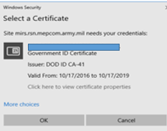
USMIRS Log-in
USMIRS then asks for your Certificate and PIN; or whenever the CAC PIN cache times out. Select your certificate from the Windows Security pop-up and click OK.
Enter your CAC PIN in the displayed ActivClient Login pop-up and click OK.

Slide 12
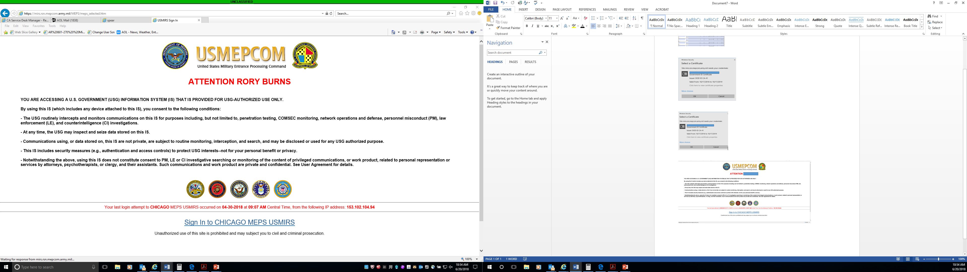
USMIRS Log-in
The MEPS “ATTENTION” screen then displays. This screen informs the user of their consent conditions for use and their last USMIRS login data including: MEPS, Date & Time, and IP address.
After reading and consenting to the conditions, click the Sign In to “CHICAGO” MEPS USMIRS link to access the MEPS’s USMIRS.
Note: “CHICAGO” is replaced with the user’s MEPS location.

Slide 13
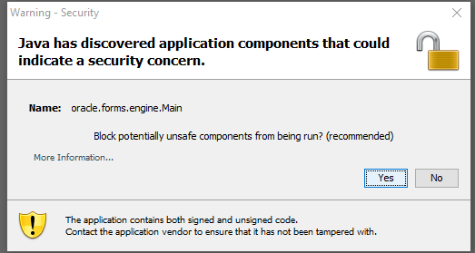
USMIRS Log-in
A Warning - Security pop-up window displays inside a new shell over the ATTENTION screen.
Click Yes in the Security pop-up, to block unsafe components from being run.
The new shell, entitled with the user’s name (redacted) and MEPS (e.g., CHICAGO), displays the Welcome/Login screen. The OU08 USMIRS LOGIN SCREEN also:
• indicates the MEPS name,
• displays the USMIRS software version number, and
• provides entry fields for a MEPS specific user login.

Slide 14
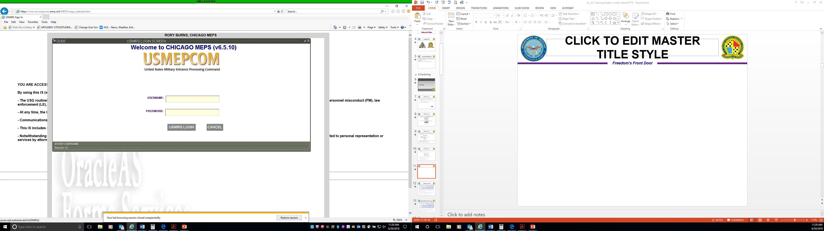
USMIRS Log-in
To login and perform USMIRS functions, enter your USMIRS account USERNAME and PASSWORD for the indicated MEPS.
Note: The user may shrink or expand buttons in the upper right corner of the “Welcome” screen, or any USMIRS screen, to reduce or enlarge the USMIRS application window.

Slide 15
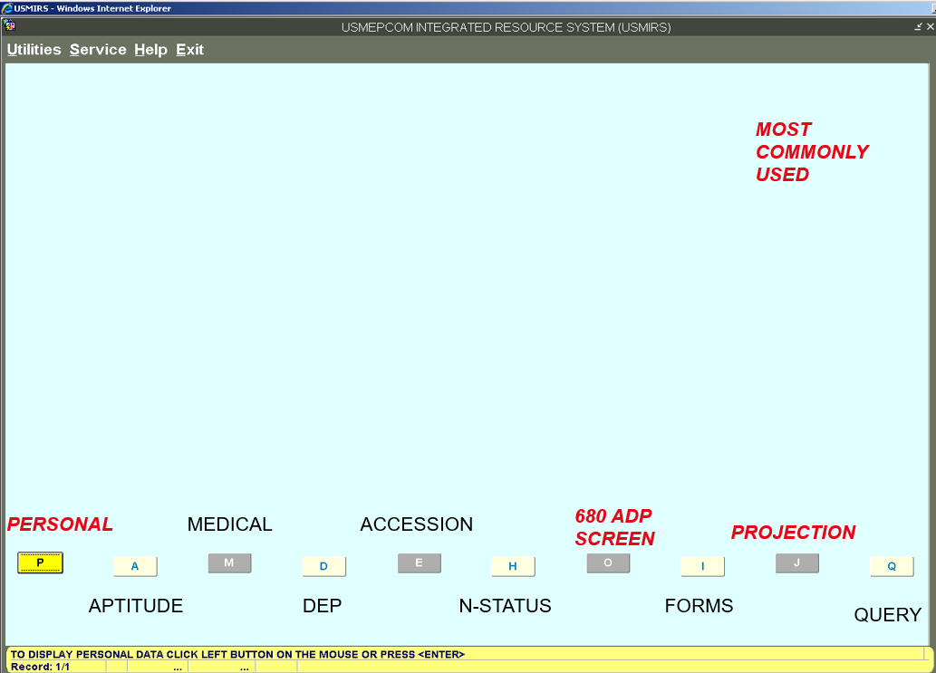
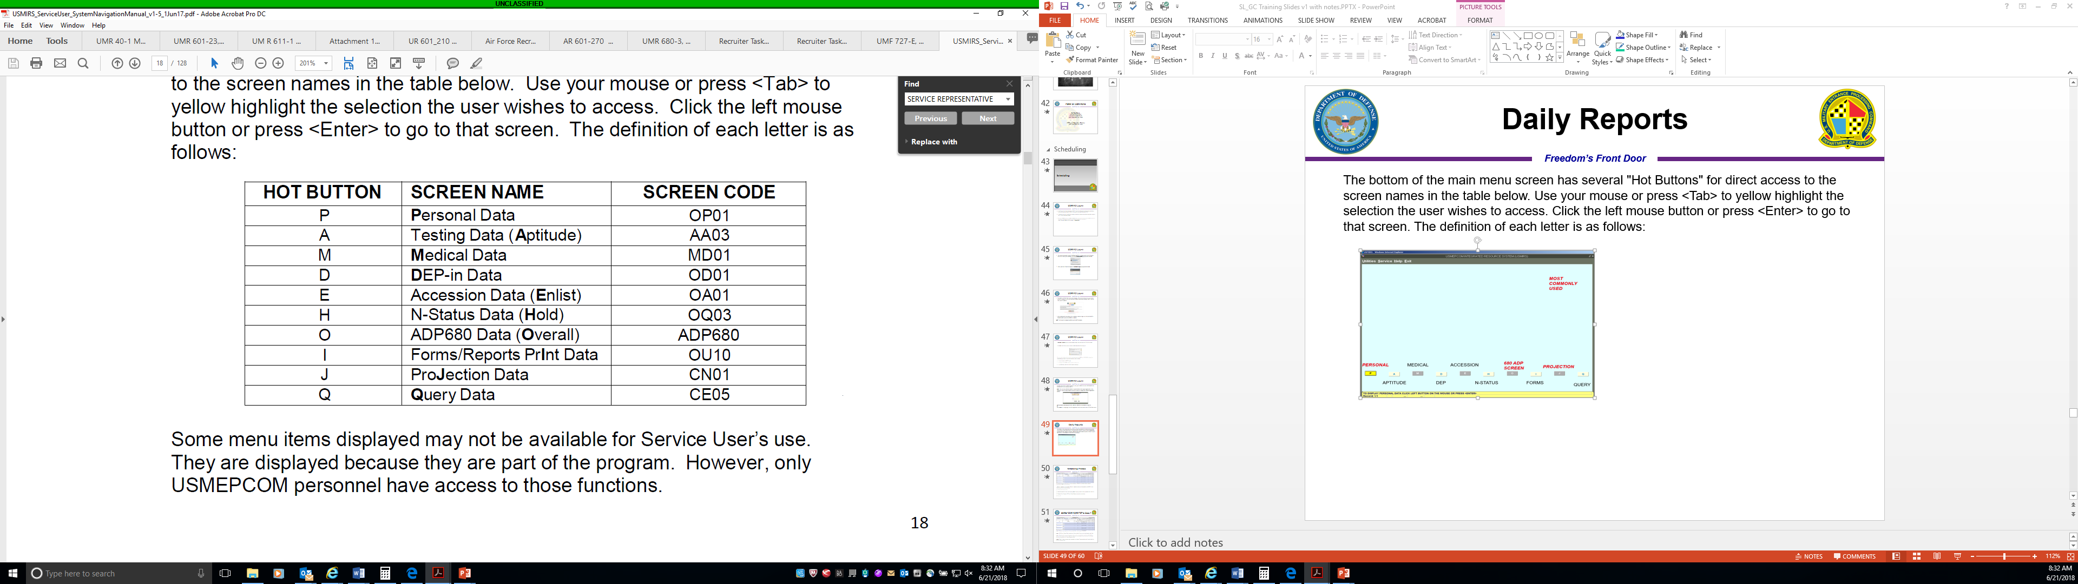
USMIRS Main Menu
The bottom of the Main Menu screen has several "Hot Buttons" for direct access to the screen names in the table below. Use your mouse or press <TAB> to yellow highlight the selection you wish to access. Click the left mouse button or press <ENTER> to go to that screen. The definition of each letter is as follows:
Some menu items displayed may not be available for Service User’s role. They are displayed because they are part of the overall USMIRS application for use by USMEPCOM personnel.

Slide 16
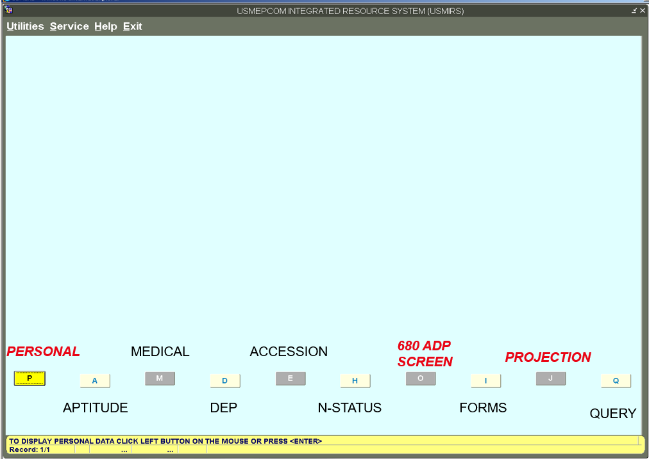
USMEPCOM PCN 680-3ADP,
Processing/Enlistee Record
MOST COMMONLY USED
Also known as the O screen
Navigate directly to the USMEPCOM PCN 680-3ADP screen (ADP680) by selecting ‘O’ or hot-key function of <CTRL+O>

Slide 17
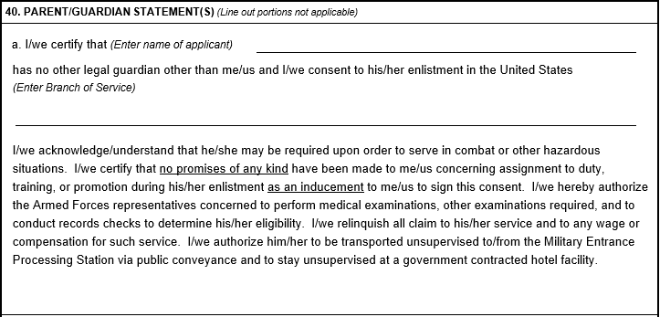
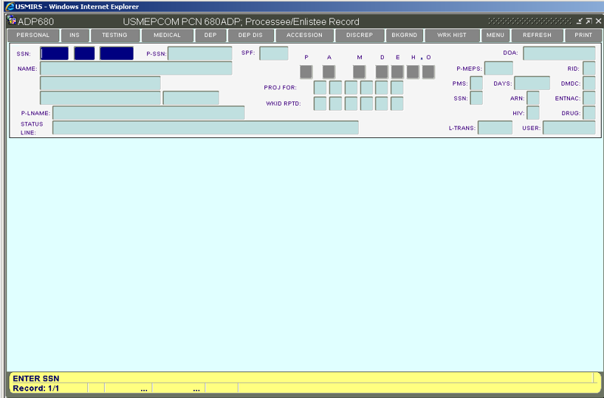
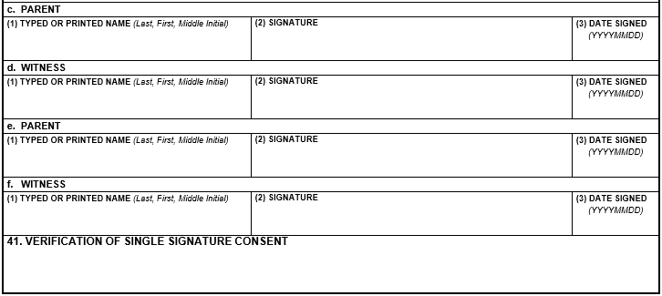
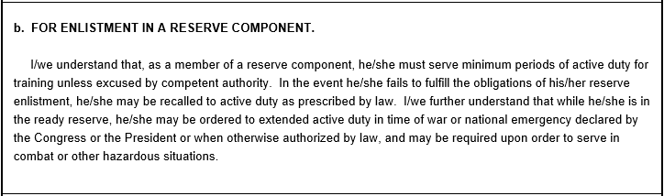
USMEPCOM PCN 680-3ADP,
Processing/Enlistee Record
Initial view of ADP680 screen; also referred to as the “O” screen allows you to enter an SSN and search for an applicant electronic record.

Slide 18
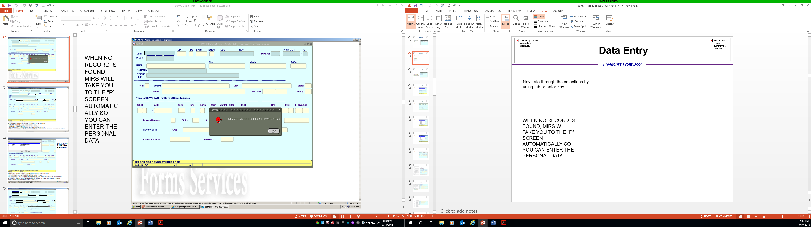
USMEPCOM Form 680-3A-E,
Request For Examination
Navigate through the data fields by using <TAB> or <ENTER> key; or select the correct response from a list of values and you will proceed to the next open data field for entry.
Also known as the P screen
Navigate directly to the USMEPCOM Form 680-3A-E Personal Data screen (OP01) by selecting ‘P’ or hot-key function of <CTRL+P>
Note: When no applicant electronic record is found, USMIRS will automatically navigate you to the OP01 screen for entry of personal data

Slide 19
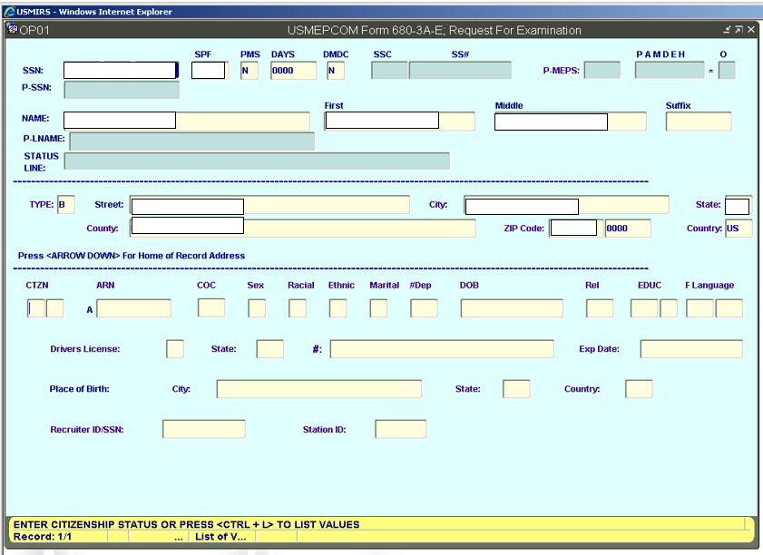
USMEPCOM Form 680-3A-E,
Request For Examination
Navigate through the data fields by using <TAB> or <ENTER> key
Enter all information, paying particular attention to:
-Spelling of name
-Date and place of birth
-SPF codes for active / reserve
Accuracy is critical; once committed and personal data record created (A000V), most errors need to be fixed by MEPS personnel

Slide 20
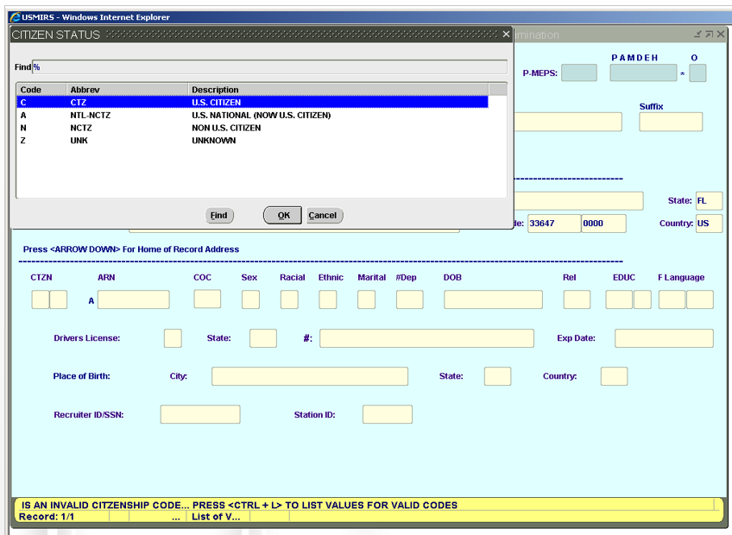
USMEPCOM Form 680-3A-E,
Request For Examination
Navigate through the data fields by using <TAB> or <ENTER> key
Make selection from list of values by:
1. using mouse
2. entering letter
3. Using arrow key
Click OK after the selection.

Slide 21
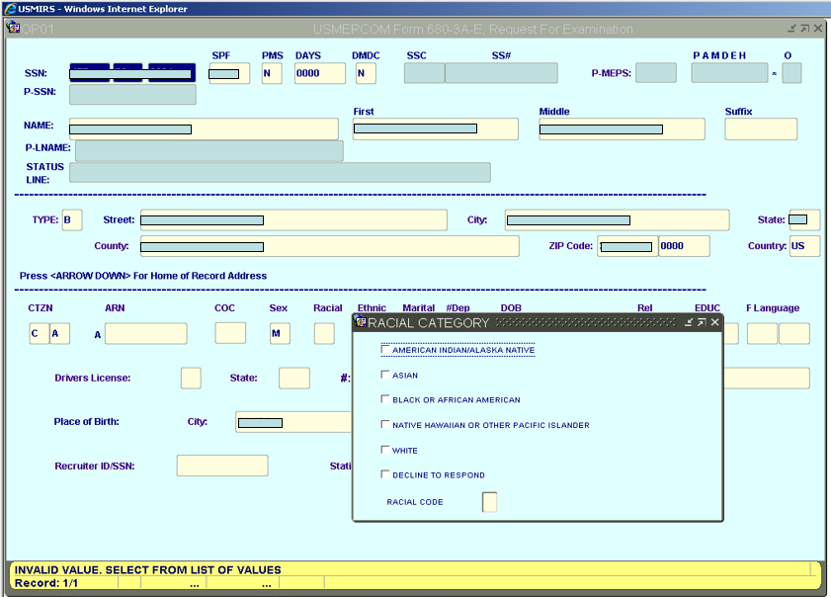
USMEPCOM Form 680-3A-E,
Request For Examination
Navigate through the data fields by using <TAB> or <ENTER> key
Racial Category

Slide 22
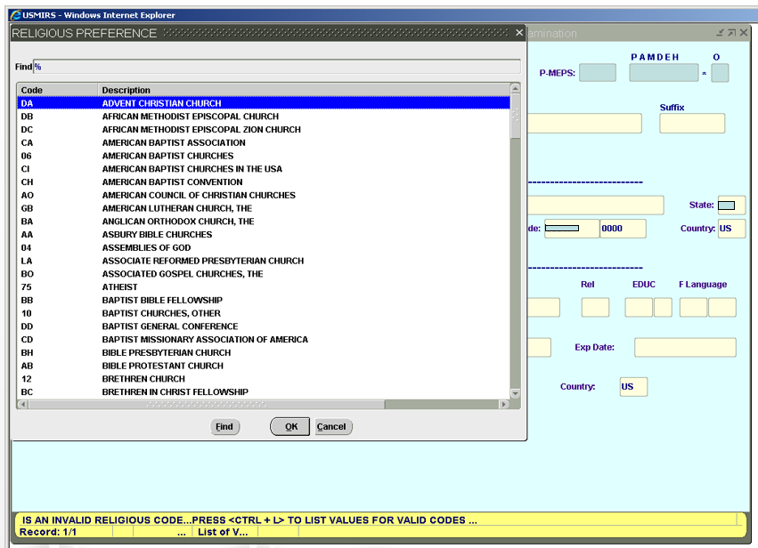
USMEPCOM Form 680-3A-E,
Request For Examination
Navigate through the data fields by using <TAB> or <ENTER> key
Religious Preference

Slide 23
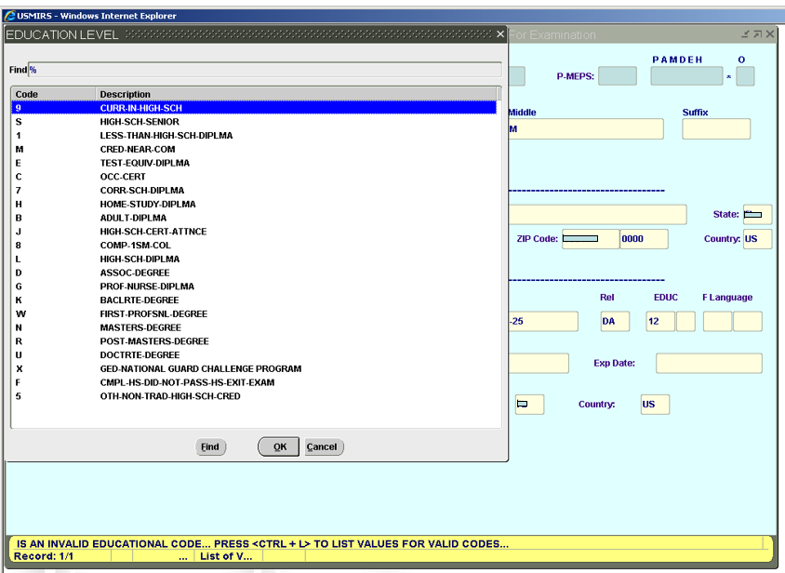
USMEPCOM Form 680-3A-E,
Request For Examination
Navigate through the data fields by using <TAB> or <ENTER> key
Education Level

Slide 24
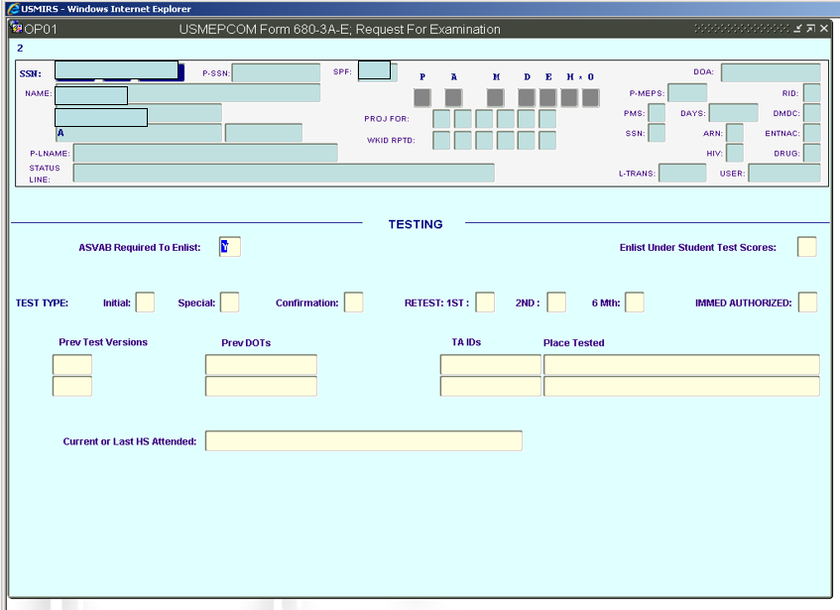
USMEPCOM Form 680-3A-E,
Request For Examination, pg. 2
Navigate through the data fields by using <TAB> or <ENTER> key
Record Header
and
Testing Information

Slide 25
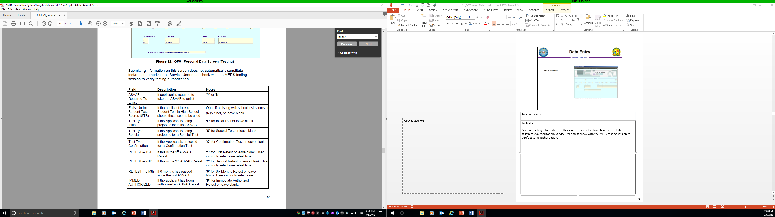
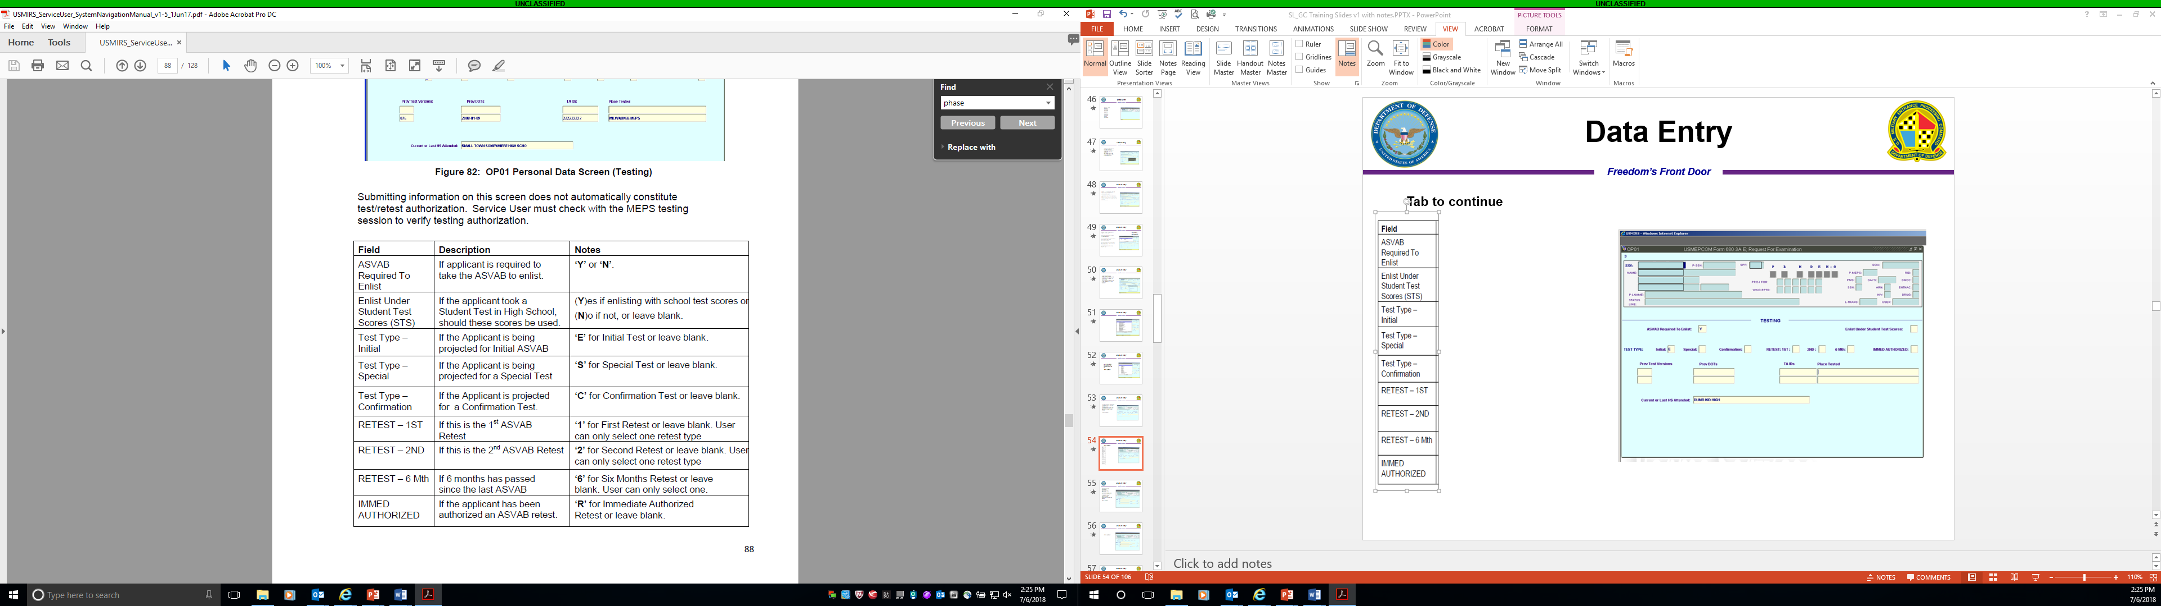
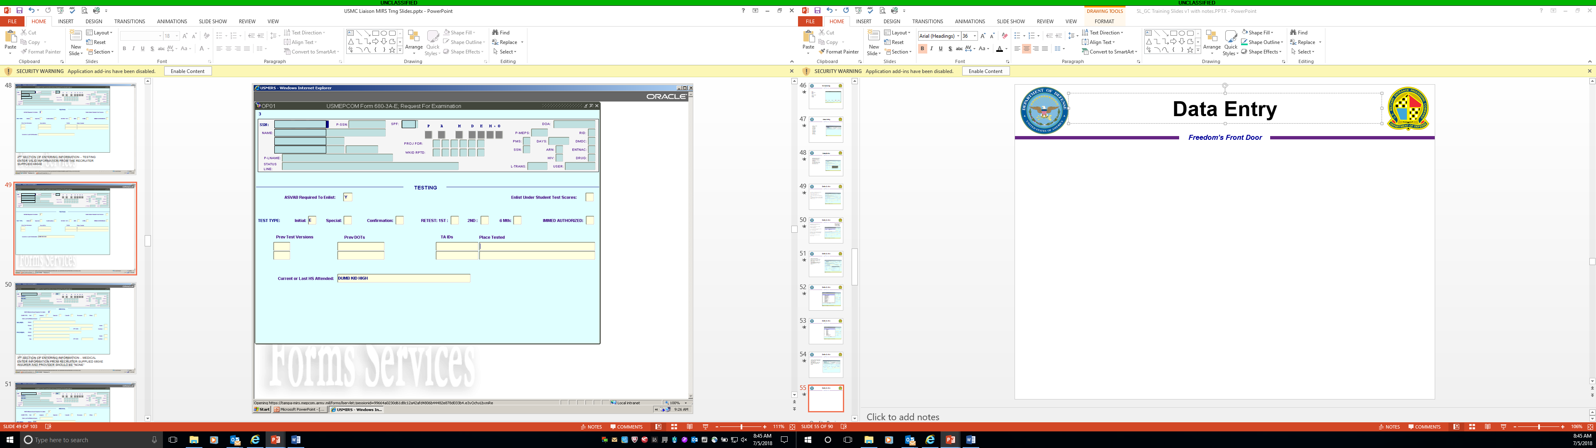
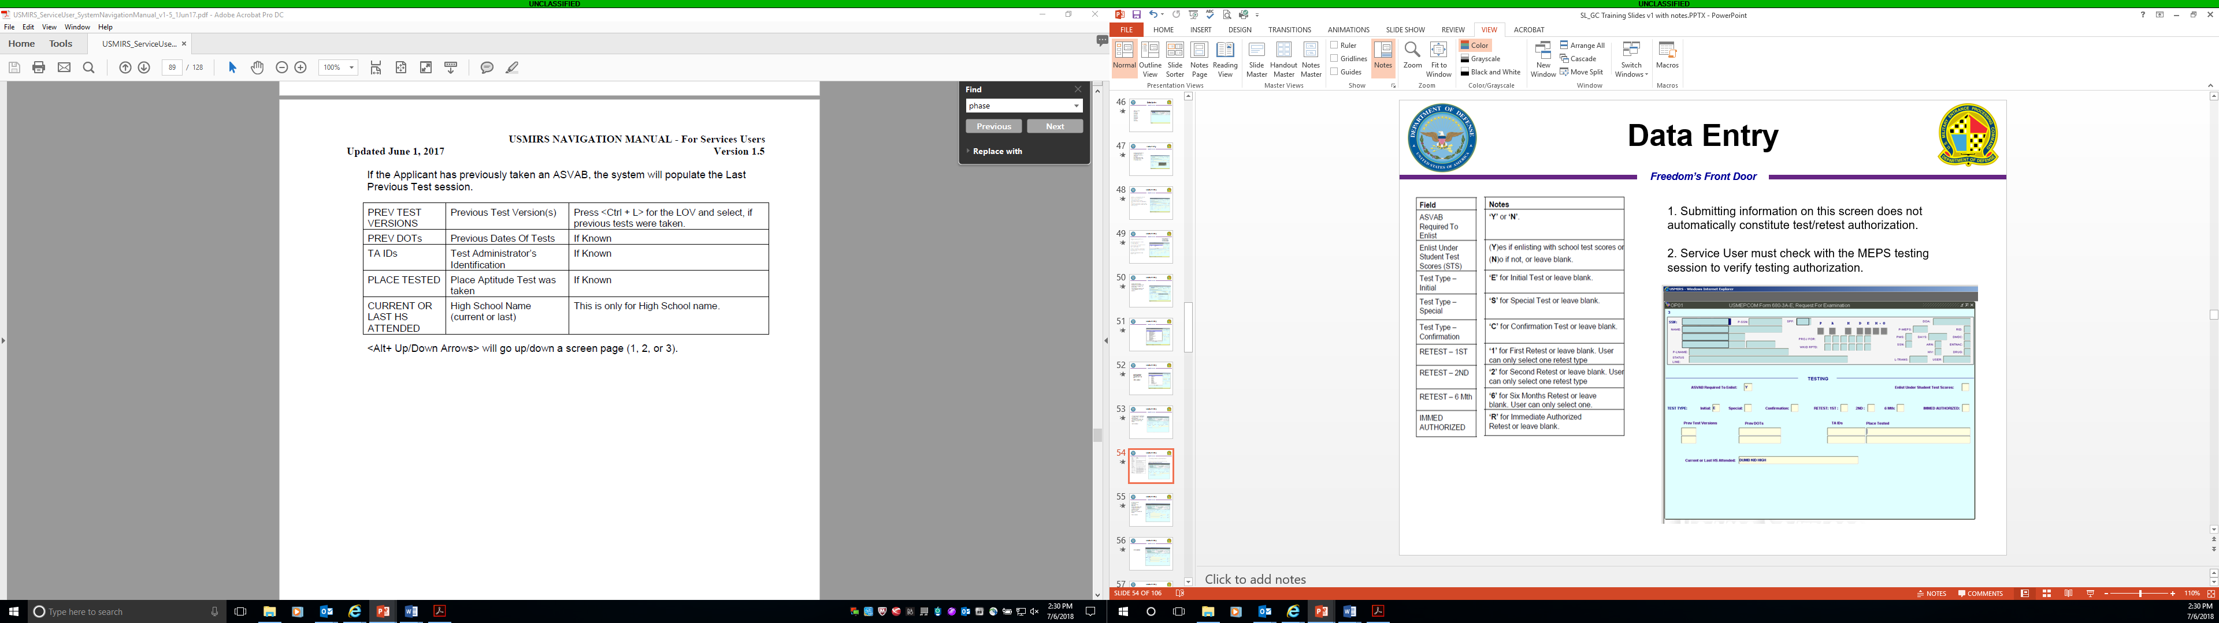
USMEPCOM Form 680-3A-E,
Request For Examination, pg. 2
Enter Testing information from recruiter-supplied UMF 680-3A-E
1. Submitting information on this screen does not automatically constitute test/retest authorization.
2. Service User must check with the MEPS testing section to verify testing authorization.

Slide 26
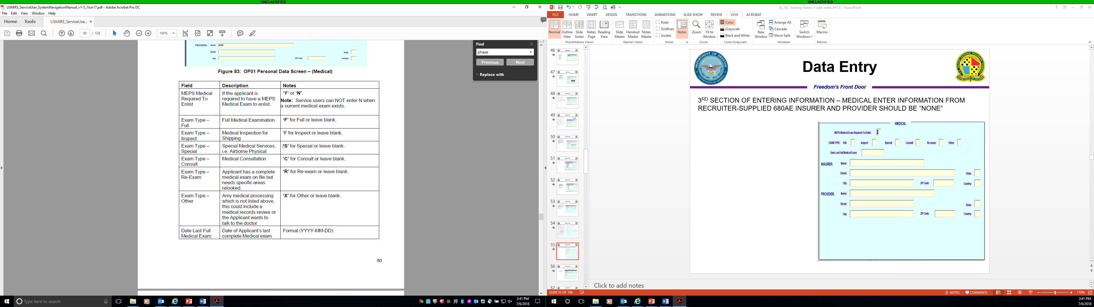
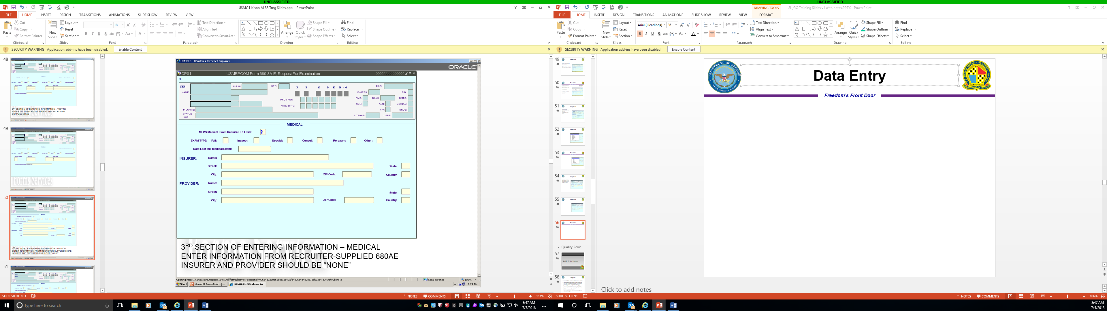
USMEPCOM Form 680-3A-E,
Request For Examination, pg. 3
Enter medical information from recruiter-supplied
USMEPCOM Form 680-3A-E

Slide 27
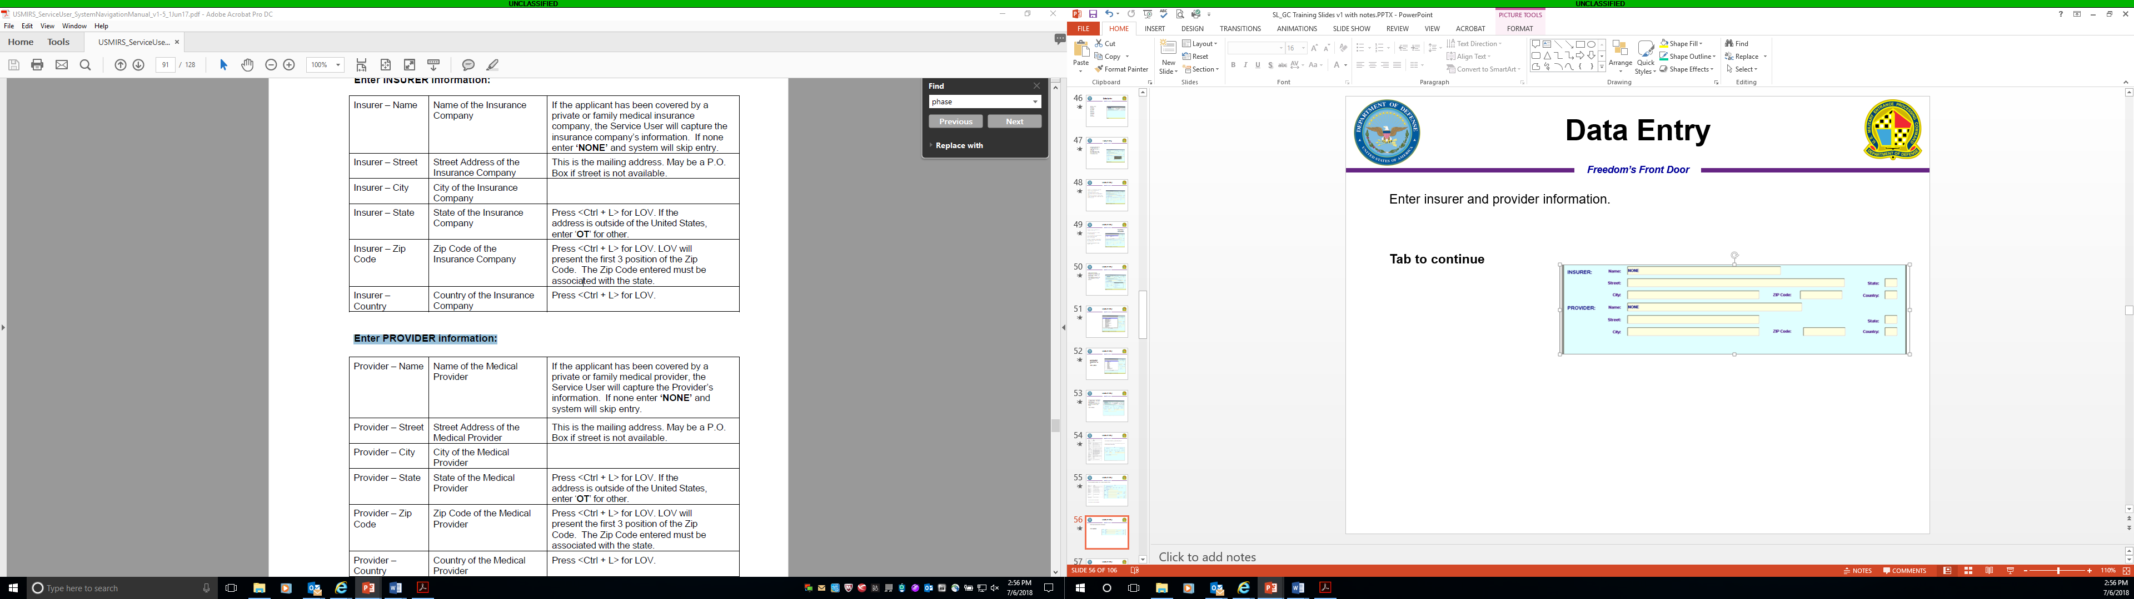
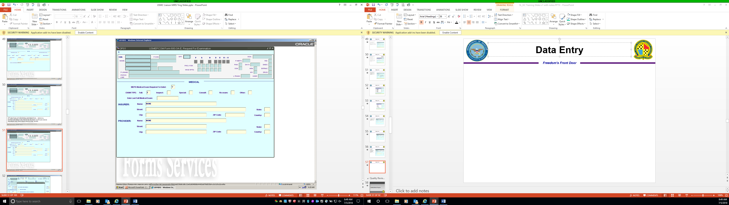
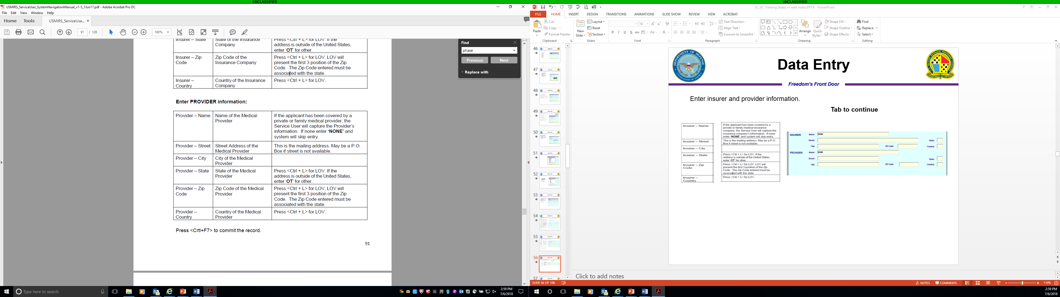
USMEPCOM Form 680-3A-E,
Request For Examination, pg. 3
Enter Medical insurer and provider information

Slide 28
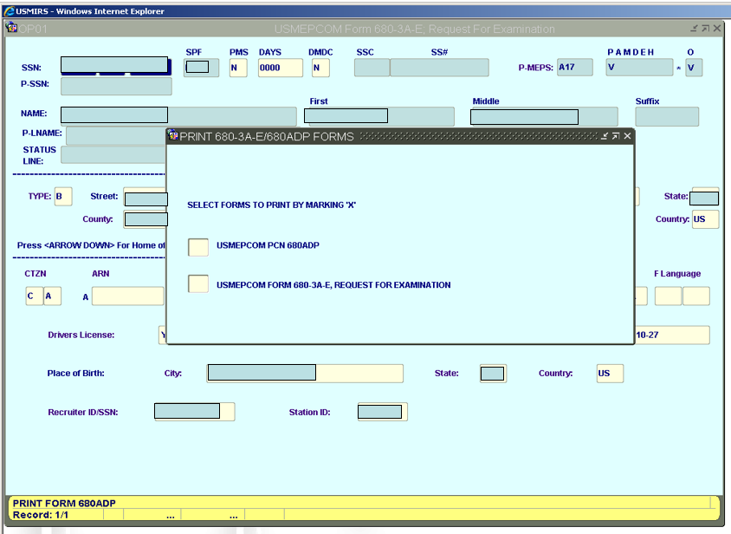
USMEPCOM Form 680-3A-E,
Request For Examination
<CTRL+F7> commits the data

Slide 29
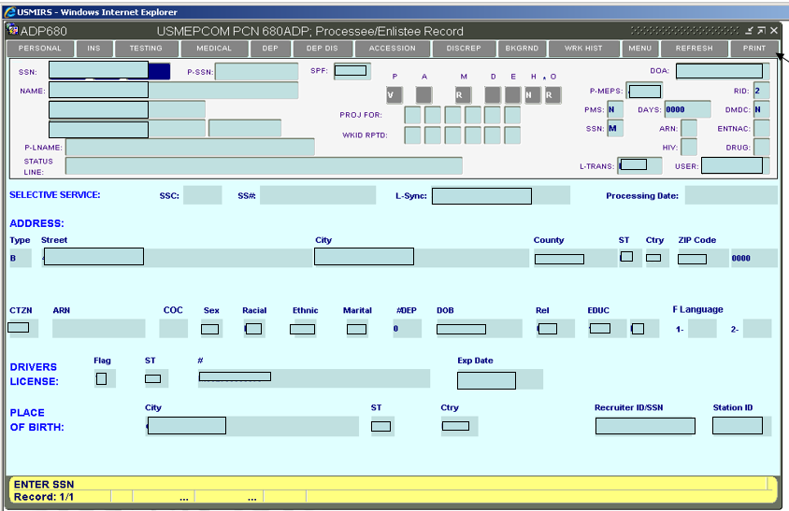
USMEPCOM PCN 680-3ADP, Processing Enlistee Record
With all data entered and committed, the personal data record is complete (A000V)
You are able to print a USMEPCOM PCN 680-ADP from here

Slide 30
System Transaction Codes
USMIRS WKID = Workload dentification Code
*Standard WKID Composite Rule
Example - B100P = Initial ASVAB
Transaction
Aptitude
Medical
Operations
Status
Add to Record Initial ASVAB No Medical No Enlistment Partially Qualified
Transaction Type |  | Aptitude |  | Medical |  | Processing |  | Status
A | Start Record | 0 | No Aptitude | 0 | No Medical | 0 | No Enlistment | A | Enlisted; Not Shipped
B | Add to Record | 1 | Initial ASVAB | 1 | Full Medical | 1 | Accession Contract | B | Enlisted & Shipped
J | Correct Record | 2 | Student ASVAB | 2 | Full Medical (Open PULHES) – Additional Information Required/Consult | 2 | DEP-In Contract | C | Shipped; Previously Enlisted
K | Delete Record | 3 | Aptitude Not Required | 3 | DD Form 2807-2 Review | 3 | DEP Discharge | D | Qualified Not Enlisted (QNE)
M | Delete DEP/ Accession Data | 4 | Invalid ASVAB | 4 | Non-MEPS Full Medical | 4 | Non-MEPS Accession | E | 2nd Positive DAT Failure *
P | Projection | 5 | Confirmation ASVAB | 5 | HIV Result | 5 | Contract, No Enlistment | G | Insufficient ASVAB AFQT; Less Than 10%
R | Delete Projection | 6 | ASVAB Retest | 6 | Inspect – No Change | 6 | ENTNAC (SAC) | H | Confirmation ASVAB Required; 20 Point Differential
S | Supplemental Record | 7 | Not Used | 7 | Inspect w/Change (PULHES Update) | 7 | Correct DEP Discharge | J | Temporary Medical Disqualification
T | Tracking Record | 8 | Special Test | 8 | Evaluation Data | 8 | Correct DEP-In | K | Confirmation Test Interview Req’d *
V | Record Verified | 9 | Correct Aptitude | 9 | Correct Medical Data | 9 | Correct Accession | L | Incomplete Medical
 |  |  |  | D | Drug Result |  |  | M | Failed Confirmation Test Interview *
 |  |  |  | M | Medical Not Required |  |  | P | Partially Qualified
 |  |  |  |  |  |  |  | R | Permanent Medical Disqualification
 |  |  |  |  |  |  |  | V | Valid Personal Data
 | Note: Asterisked codes are discontinued from further use (deprecated); however, they remain valid in historical entries. |  |  |  |  |  |  | X | Aptitude/Medical Not Required For Enlistment (B300/B0M0)
 |  |  |  |  |  |  |  | Z | Errored Record

Slide 31
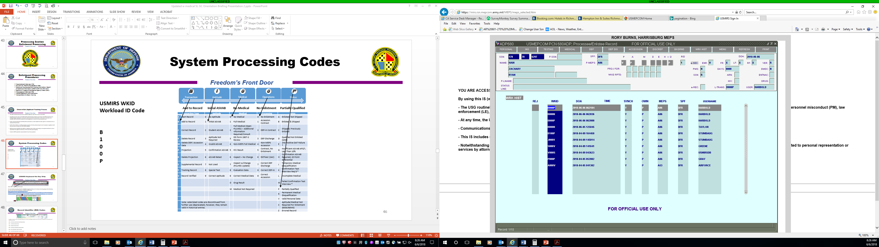
USMEPCOM PCN 680-3ADP Work History
The following WKIDs do not follow the standard WKID composition rules.
The following WKIDs are displayed as seen on ADP680 screen in USMIRS – Work History
B000N | Create “N” Status
B000P | Clear “N” Status
B001D | Delete Accession Data
B003D | DEP Discharge
B005D | Delete DEP Data
J000E | Correction to DD Form 93
J000P | Projection Correction
J001C | Correction to DD Form 4/1 - 4/2
J002C | Correction to DD Form 4/3
K000K | Record Delete
M005 | Delete Accession Data
M006 | Delete DEP & Accession Data
P000P | Projection Record
R000P | Projection Deletion
S000E | DD Form 93
S000I | e-Security Partial Enrollment
S000V | e-Security Full Enrollment
S001C | DD Form 4/1 - 4/2
S002C | DD Form 4/3
T000O | Tracking Check-out (MOT)
T000I | Tracking Check-In (MIN)
Other WKID Codes

Slide 32
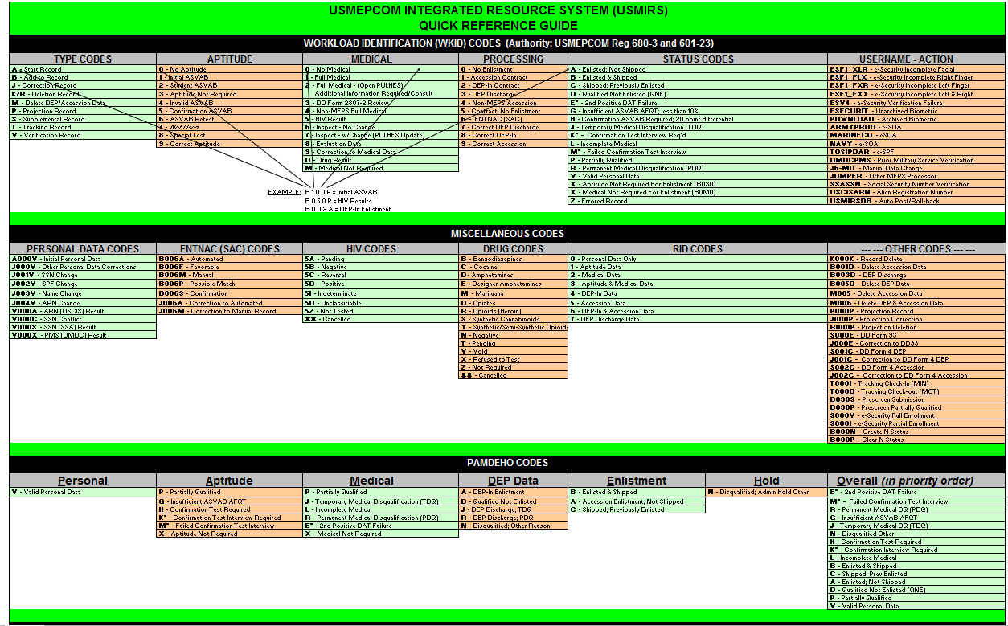
USMIRS Quick Reference Guide
Notes:
Currently under revision

Slide 33
Projection Scheduling

Slide 34
Projection Scheduling
The projection scheduling process is globally centralized at the HQ USMEPCOM Centralized Relational Database (CRDB). Only one owner (permanent or temporary owner) will be allowed to add, delete, or change data for a specific SSN.
Only one projection will exist for the same SSN record for a specific processing date (no duplicate projections) unless the previous projection is deleted. Creating a projection for someone who is already projected (two for the same day) will cause the first projection to be deleted and the latest one will be the valid projection.
Only way for more than one projection to be made per applicant (same SSN) is as long as they are for different processing dates.

Slide 35
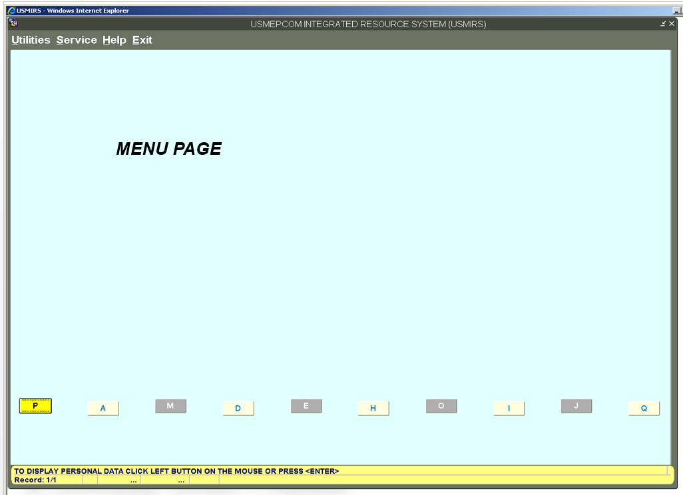
Projecting an Applicant
Navigate through menus/screens by using <TAB> or <ENTER> key
Navigate directly to the USMEPCOM Form 727-E Processing List Projection screen (CN01) by selecting ‘J’ or hot-key function of <CTRL+J>

Slide 36
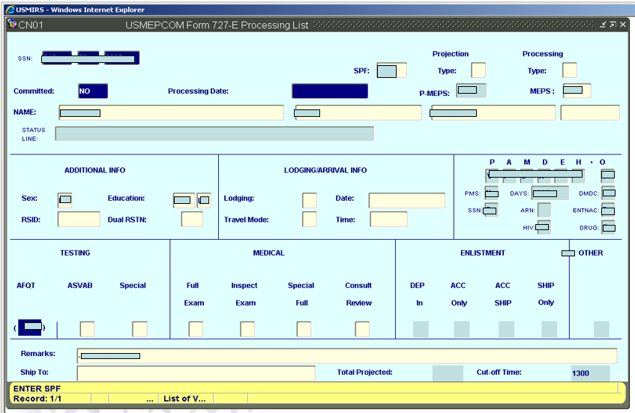
USMEPCOM Form 727-E; Processing List
Navigate through the data fields by using <TAB> or <ENTER> key; or select the correct response from a list of values and you will proceed to the next open data field for entry.

Slide 37
PROJECTION TYPES VS.
PROCESSING TYPES
Projection Types
P | Projection
W | Walk-in
H | Holdover, next day processor
N | Night test
T | Night test, next day projection
S | Same day processor
K | Walk-in, same day processor
M | MET site testing
Processing Types
D | DEP-in
A | Access only
B | Access and ship
C | Ship only
S | Non-MEPS shipper
X | Other processing
Notes:
Projection Type:
P - Projection
W - Walk-in
H - Holdover, next day processor
N - Night test
T - Night test, and next day projection
S - Same Day Processor
K - Walk-In, and Same Day Processor
M - MET Site testing
Processing Type:
D - DEP- In
A - Access only
B - Access and Ship
C - Ship only
S - Non-MEPS Shipper
X - Other processing

Slide 38



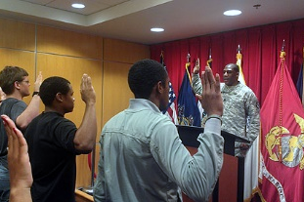
SAME DAY PROCESS (SDP)
Qualification Testing
Medical Examination
Sworn In
Note:
Projection type: S
Medical brief before ASVAB testing
Medical data entered into ERM and PULHES annotation on profile, if the applicant:
  Does not return from ASVAB test
  Front-loaded
This must be documented on the DD Form 2808

Slide 39
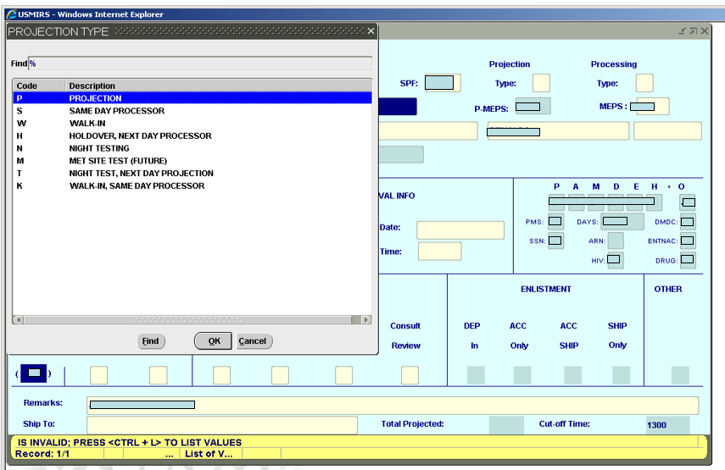
USMEPCOM Form 727-E; Processing List
Navigate through the data fields by using <TAB> or <ENTER> key
Projection Type

Slide 40
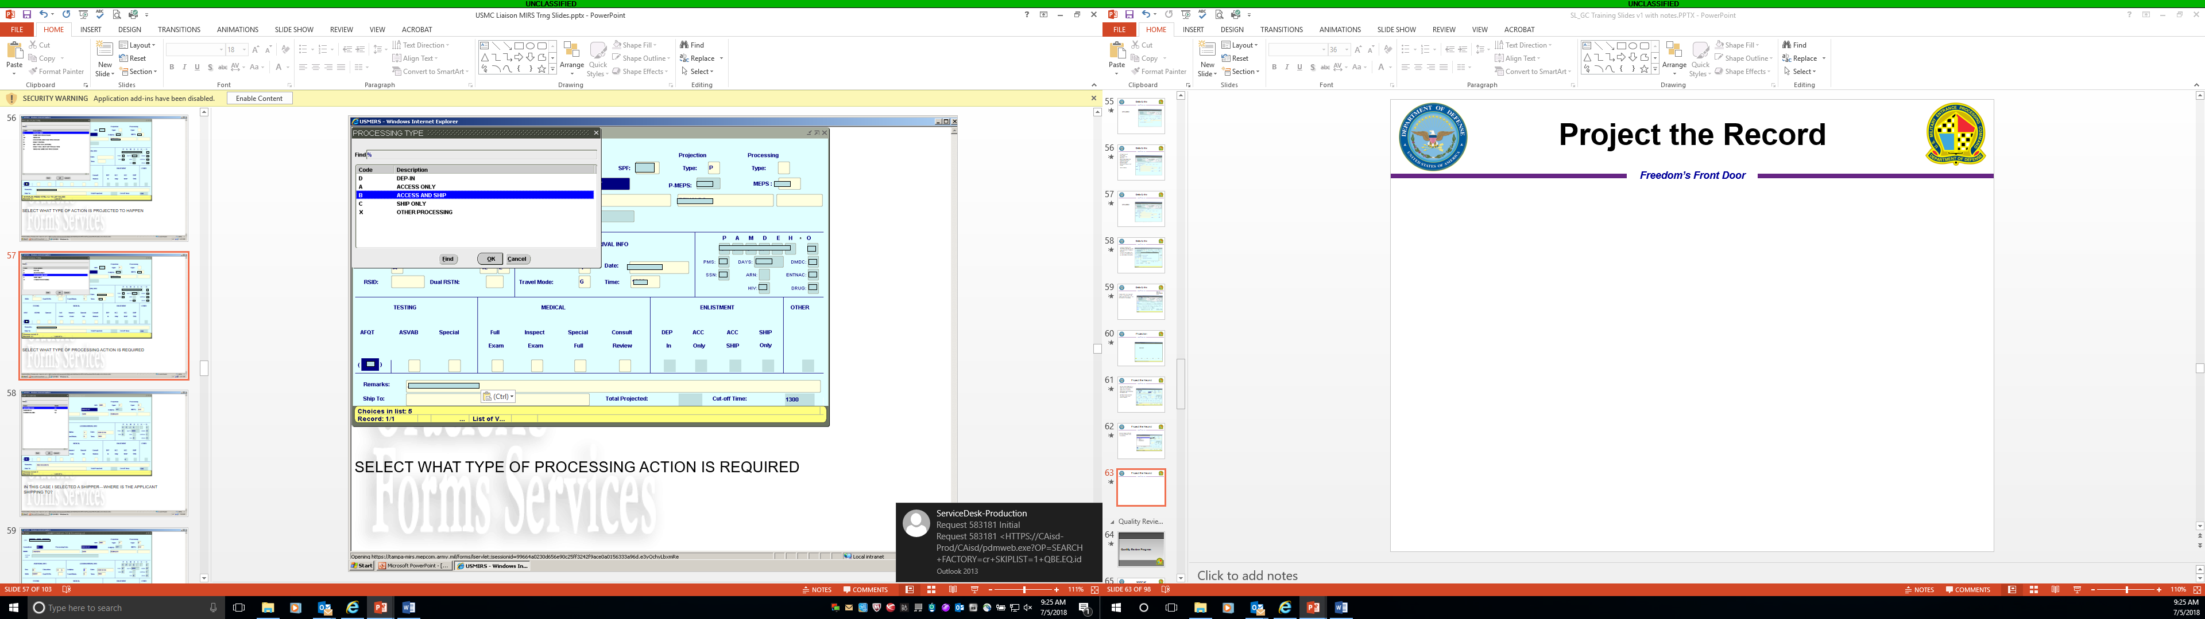
USMEPCOM Form 727-E; Processing List
Navigate through the data fields by using <TAB> or <ENTER> key
Processing Type

Slide 41
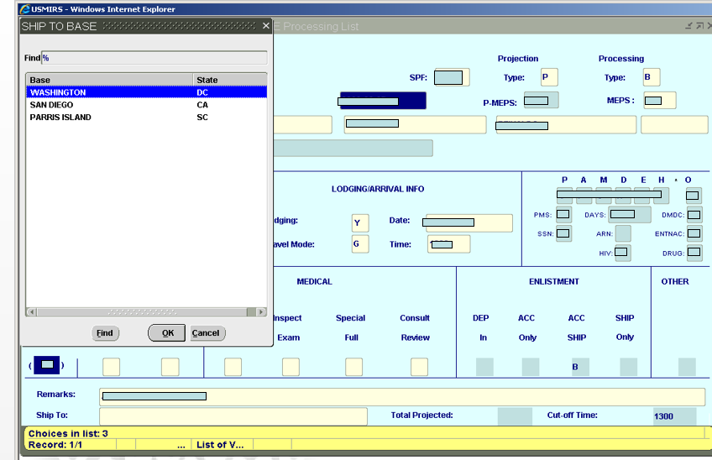
USMEPCOM Form 727-E; Processing List
Navigate through the data fields by using <TAB> or <ENTER> key
Ship To Base

Slide 42
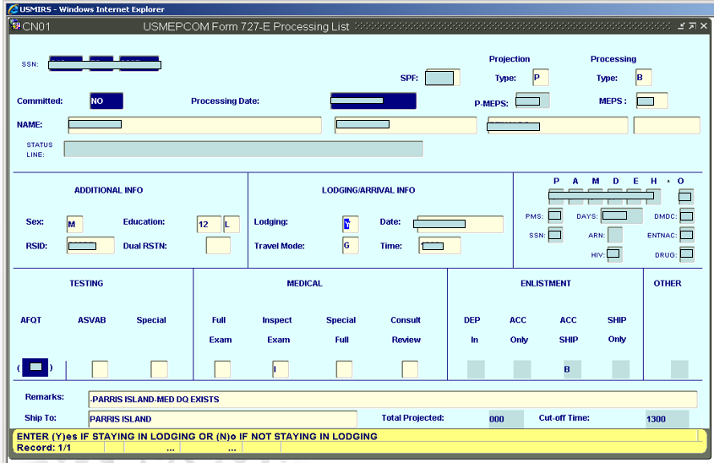
USMEPCOM Form 727-E; Processing List
<CTRL+F7> commits the data

Slide 43
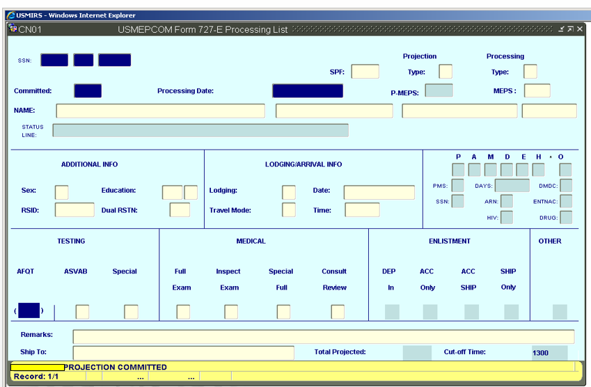
USMEPCOM Form 727-E;
Processing List
With all data entered and committed, the projection data record is complete (P000P)

Slide 44
Opening Procedures

Slide 45
Check-In/Out (Applicant Tracking/Accountability) Process
The MEPS will biometrically check-in (T000I) applicants upon their arrival at the MEPS.
All applicants that come to the MEPS will be biometrically checked in and out by each MEPS functional area (Testing, Medical, Operations and Service Liaison) and at the Control Desk. In the event e-Security is not available, MEPS will still be required to check applicants in and out of every functional area.
SL/GCs should understand and follow these procedures as well. Statistics for time spent in a functional area is a USMEPCOM Command interest item.
SL/GC will not delete or modify projection records on the day of processing. Do not re-project an applicant until they have been checked-out of the MEPS (T000O).
MEPS personnel will MEPS-Out (MOT) an applicant when further processing is not required and there is not an expectation the applicant will return at the end of the processing day.
Contact a MEPS operations representative if you have questions.

Slide 46
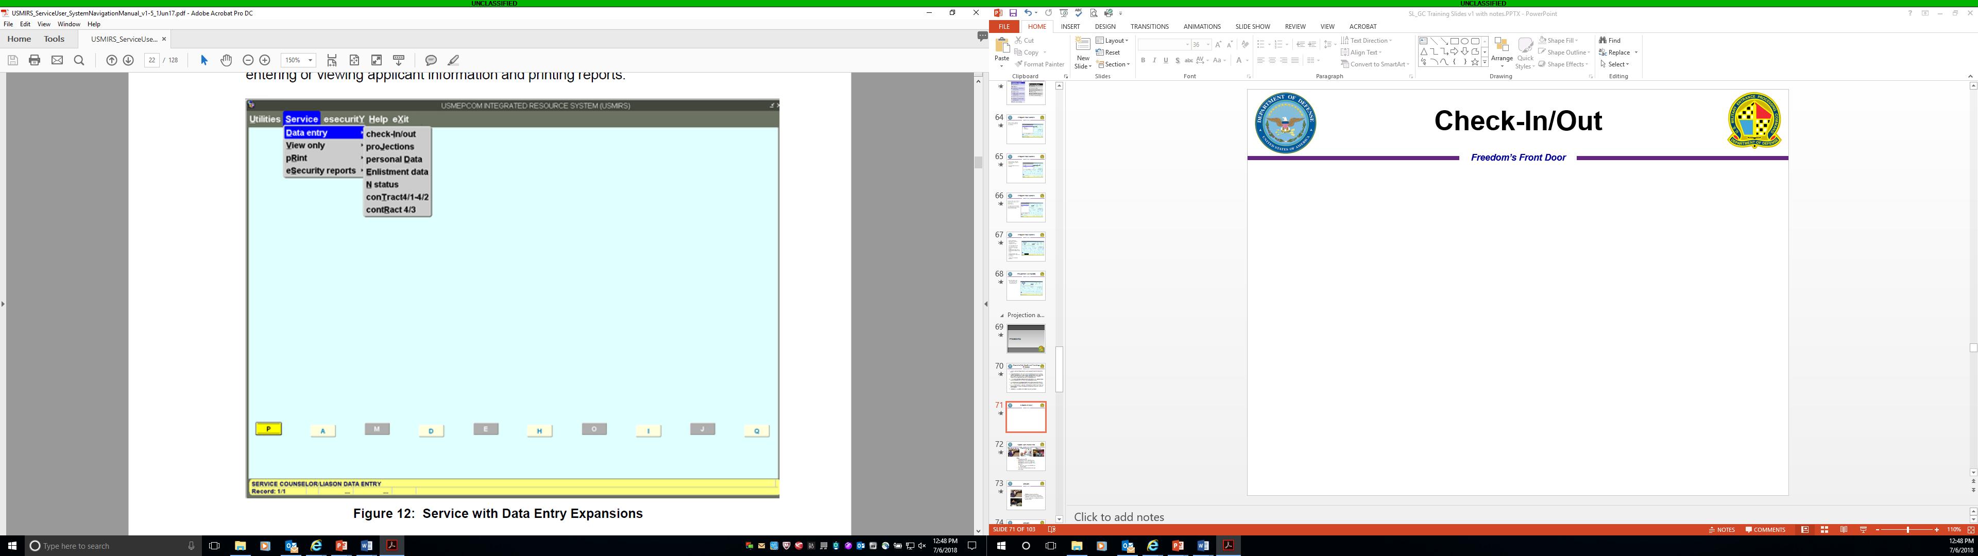
Check-In/Out
Applicant location should be known at all times, during processing.

Slide 47
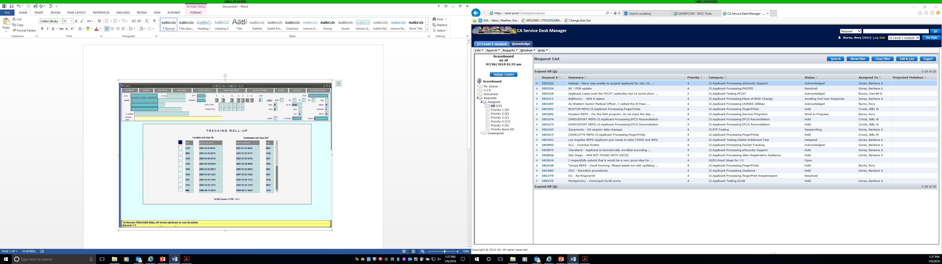
Check-In/Check-Out; TA01
Applicant Location in MEPS (6) Query
Enter 'X' in APPLICANT LOCATION IN MEPS selection 6. Press <ENTER>.
SSN – enter the Social Security Number and press <ENTER>.
• If SSN is found, the applicant's data will be displayed on TA01 Check-In / Check-Out screen.
• If not found a message will be displayed, “CAN ONLY VIEW APPLICANT LOCATION FOR ENTERED SPF” or “TRACKING DATA DOES NOT EXIST”.
Use the <UP/DOWN ARROW> or Scroll Bar to view the Tracking Roll-Up list.
Press <CTRL+F4> to exit the Tracking Roll-Up list.

Slide 48
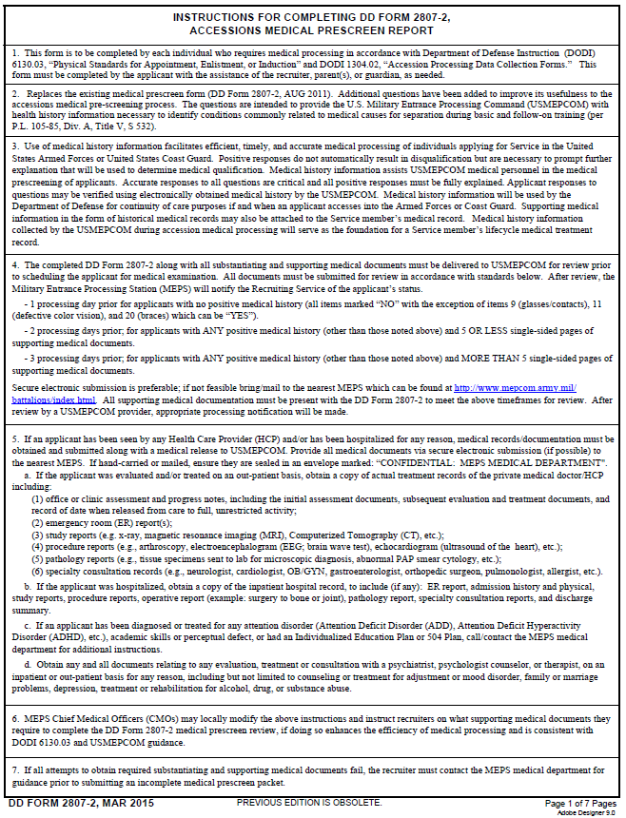
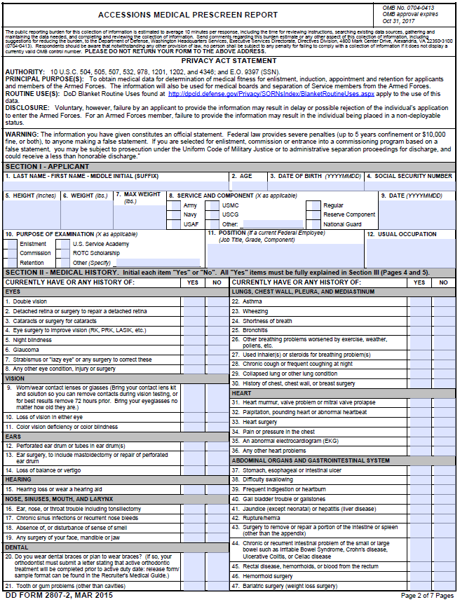
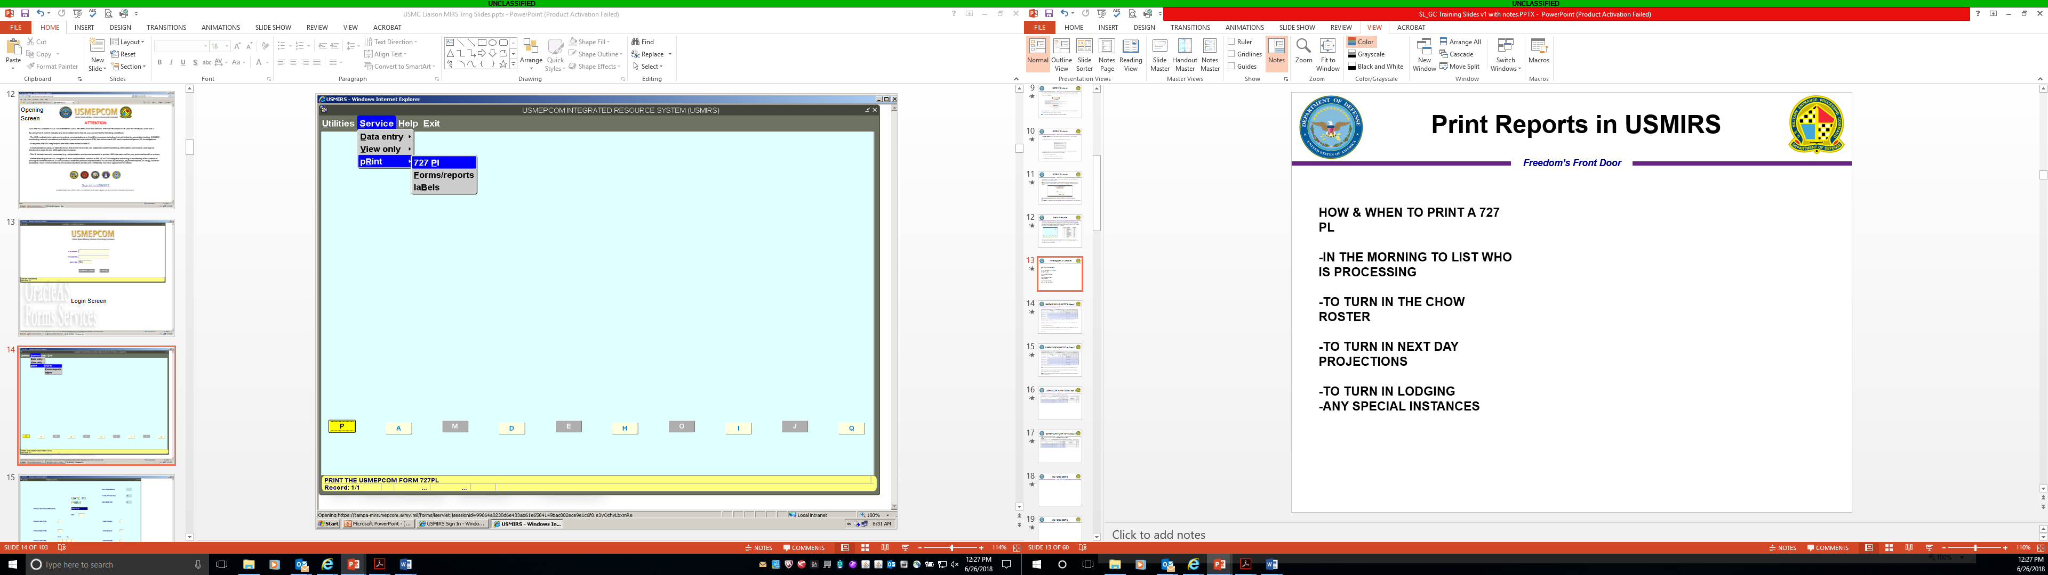
USMIRS Report Printing
HOW & WHEN TO PRINT A USMEPCOM Form 727-E PL
-IN THE MORNING TO LIST WHO IS PROCESSING
-TO TURN IN THE LUNCH ROSTER
-TO TURN IN NEXT DAY PROJECTIONS
-TO TURN IN LODGING
-ANY SPECIAL INSTANCES

Slide 49
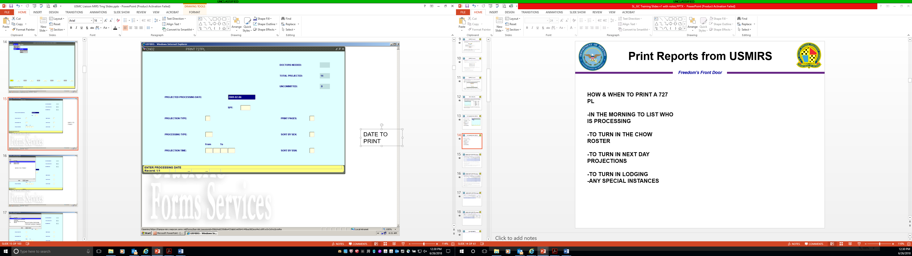
Print USMEPCOM Form 727-E PL
(CN02)
Step 1. Select the projected processing date.
Additional selections are:
Step 2. SPF
Step 3. Projection Type
Step 4. Processing Type
Step 5. Projection Time
Step 6. Print Pages
Sort By Sex
Sort By SSN
Proceed to review each step

Slide 50
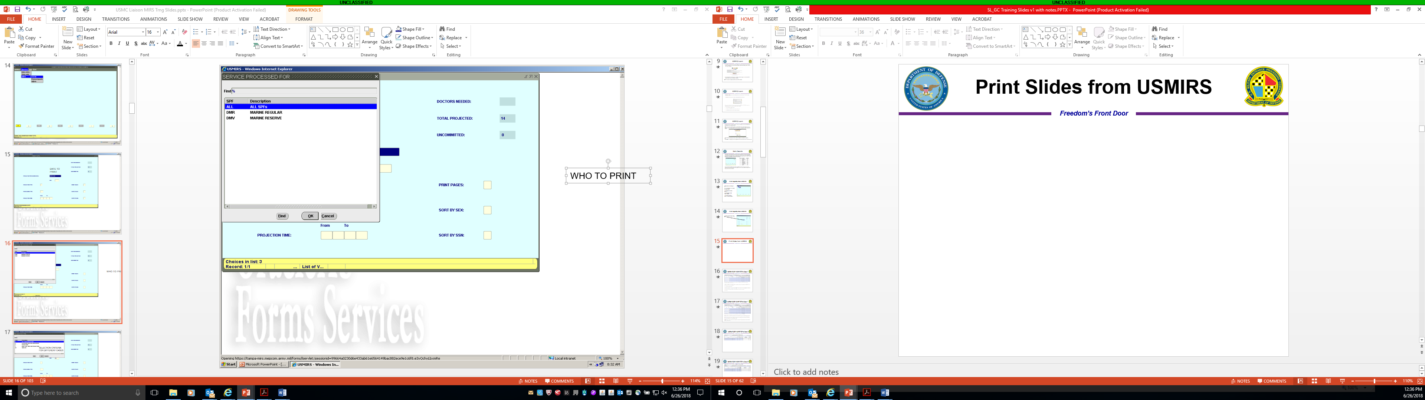
Print USMEPCOM Form 727-E PL
(CN02)
Step 2. Select: Service Processed For (SPF).
The 3 letter SPF identity code for each Service is explained below:
The first 2 letters is the Service Branch
DA – Army
DN - Navy
DM – Marine Corps
DF – Air Force
GP – Coast Guard
The third letter represents the component, Regular, Reserve, Guard, or Non-applicant.
R – Regular
V – Reserve
G – Guard
Z – Non-applicant

Slide 51
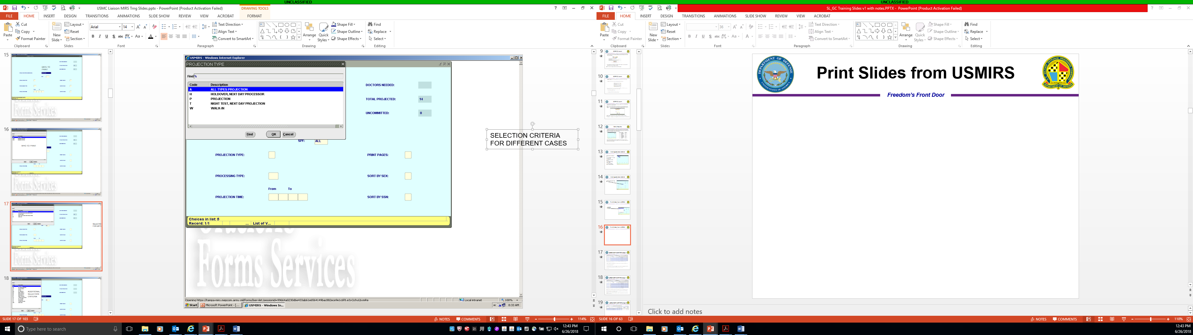
Print USMEPCOM Form 727-E PL
(CN02)
Step 3. Select your Projection Type.
A – All
H – Holdover, Next Day Projection
P - Projection
T – Night Test, Next Day Projection
W – Walk-In

Slide 52
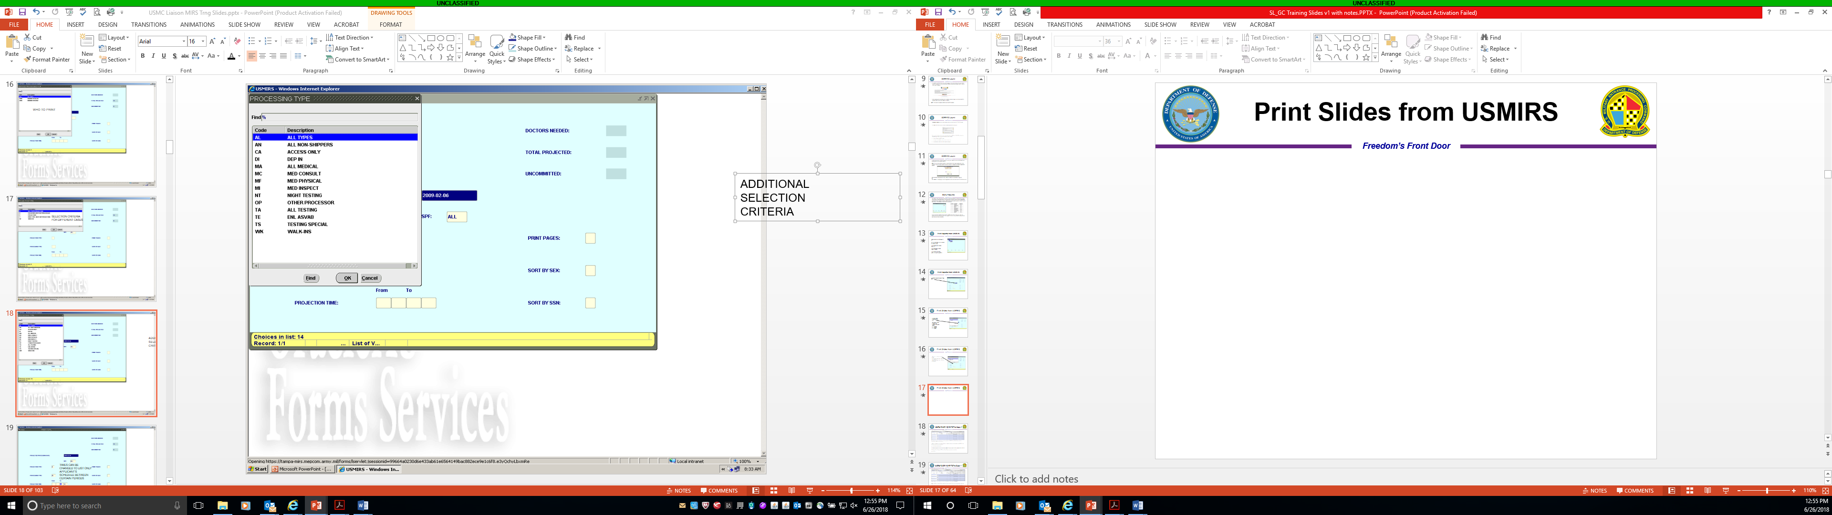
Print USMEPCOM Form 727-E PL
(CN02)
Step 4. Selecting Processing Type; examples below
AL – All Types
AN – All Non Shippers
CA – Access Only
DI – DEP IN
MA – All MEDICAL
MC – Med Consult
MF – Med Physical
MI – Med Inspect
NT – Night Testing
OP – Other Processor
TA – All Testing
TE – Enl ASVAB
TS – Testing Special
WK – Walk-Ins

Slide 53
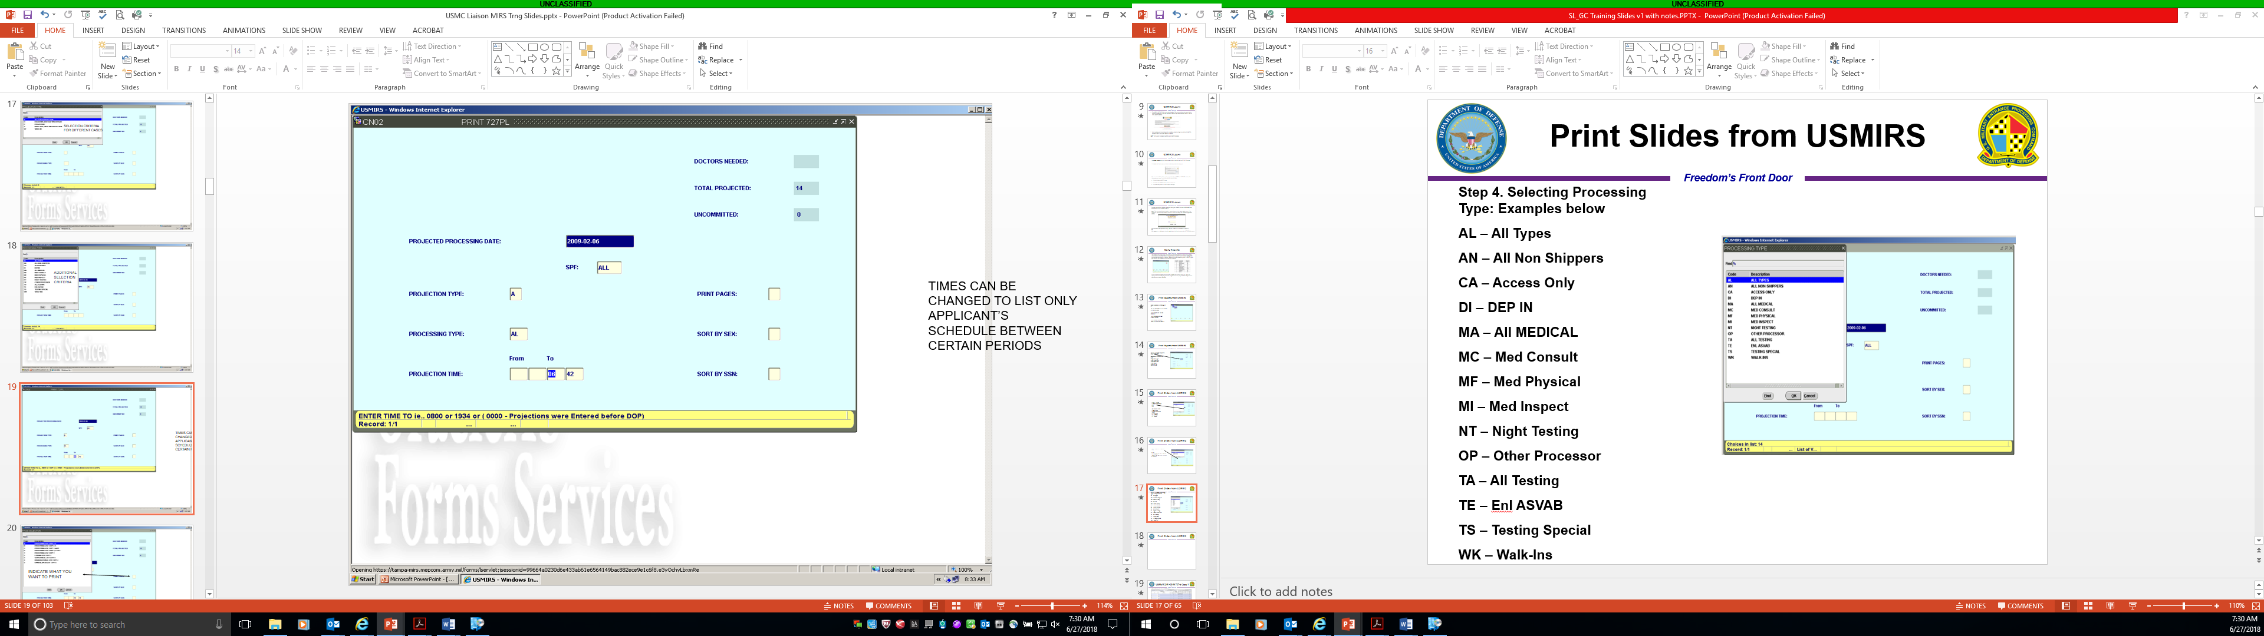
Print USMEPCOM Form 727-E PL
(CN02)
Step 5. Processing Time
This step can be modified by entering a specific (from – to) time period.

Slide 54
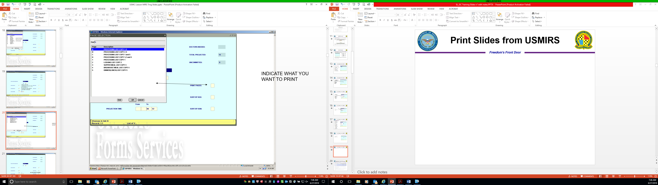
Print USMEPCOM Form 727-E PL
(CN02)
Step 6. Print Pages; pages are listed below:
A - Processing List Copy 1-5
B - Processing List Copy 2-5
C - Processing List Copy 1 and 5
D - Processing List Copy 1,2, and 5
1 - Processing List Copy 1
2 - Lodging List
3 - Supper Meal List Copy 3 N/A
4 - Breakfast Meal List Copy 4 N/A
5 - Dinner (Lunch) List Copy 5

Slide 55

Print USMEPCOM Form 727-E PL
(CN02)
The remaining steps are used to sort form by SSN or Sex; rarely used.
Final step is to press <SHIFT+F6> to print the requested USMEPCOM Form 727-E PL

Slide 56



USMEPCOM Form 727-E; Processing List
USMEPCOM Form 727-E Copy 1: Processing List
USMEPCOM Form 727-E Copy 2: Lodging Authorization and Receipt Voucher
USMEPCOM Form 727-E Copy 5: Dinner (Lunch) Meal Authorization and Receipt Voucher

Slide 57

Process Results (CR01)
Navigate through menus/screens by using <TAB> or <ENTER> key

Slide 58

MEPS Processing Workload
Check Drug Alcohol Test (DAT) Results every morning; ZHM002
The date is a default; however, the data field can be changed to the date the user prefers.
Select your SPF
Select your item choice; e.g.,
19 Host DAT Results

Slide 59

MEPS Processing Workload
Item 19. Host DAT Results will display with a by SSN list.

Slide 60

Print Forms; OU10
HOW TO PRINT FORMS YOU MAY NEED

Slide 61

Forms
Select form by using <ARROW> keys or press <ENTER> to accept

Slide 62

Forms and Reports; OU10
ENTER SSN FOR APPLICANT REQUIRING THE FORM
PRESS <ENTER> TO AUTOMATICALLY PRINT

Slide 63


Print Labels; TP07
HOW TO PRINT APPLICANT IDENTIFICATION BADGE and FILE RECORD LABEL
1
2

Slide 64


Print Labels; TP07
3
4
SELECT CATEGORY TO PRINT
SELECT WHAT TYPE OF BADGE/LABEL and enter “X”

Slide 65
Aptitude Testing

Slide 66


Aptitude Testing
Multiple aptitude test batteries
One of several criteria to determine
eligibility to enlist in the Armed Forces
Career exploration partially determined
by test scores

Slide 67
ASVAB Testing
ASVAB
Complete UMF 680-3A-E (Provide instructions)
Data entry
Retest Procedures
First Retest
Second and Subsequent Retest
Projection Types
Confirmation Tests
Confirmation Scores

Slide 68
Additional ASVAB Tools
AFQT Predictor Test:
Used to predict performance on the Armed Forces Qualification Test (AFQT)
To register, visit iCAT Authorization & Reporting page by copying and pasting the following link onto your URL:
  https://www.dmdc.osd.mil/icat-ar/
PiCAT and Verification Test.
CEP-Career Exploration Program or Student Testing.
Note: USMEPCOM’s service to the school is consistent, regardless of release option.
Additional Tool/Test

Slide 69

Special Purpose Testing
Note:
Military personnel who are changing components (or Services) can be administered a special test at the MEPS without an MFR
Completed USMEPCOM 680-3A-E, Request for Examination, is required
Reference Procedures for Completing the USMEPCOM Form 680-3A-E @ http://www.mepcom.army.mil/portals/112/documents/680-3a-e_instructions_Jun_18.pdf

Slide 70
Special Purpose Testing
Submit MFR from unit commander requesting the MEPS Commander to administer/authorize the test
MFR must include:
  Reason for taking the test
  Statement that the member’s personnel records indicates eligibility to take a particular test
  An address to send the results
  Active Duty Marines (including officer programs) must get permission in writing from the Commandant of the Marine Corps
Military personnel who are changing components or services can be administered a special test at the MEPS without a MFR.
  Completed USMEPCOM 680-3A-E is required
Available to:
Note: Special purpose testing will not be scheduled/conducted in to impair enlistment or student testing missions.
Individuals in Service DEP
Non-prior Service
Military Service Members
Who are not changing components or Service on ETP basis only
At least 17 years of age
Arrange test at a military installation for in-Service purposes

Slide 71
SPECIAL PURPOSE TESTING
Tests specific to the service & for specific occupational specialties
Can be administered the same day as the ASVAB
ASVAB administered prior to special purpose tests (except AFOQT)
MEPS personnel will establish a schedule for the most common tests
The computerized Defense Language Aptitude Battery (C-DLAB)
(tests administered via the CAT-ASVAB system will also be available whenever the system is available)
Special purpose testing will not interfere with ASVAB testing
Special purpose testing at locations other than the MEPS is not authorized (exception of those special purpose tests conducted by the Services overseas)

Slide 72
Medical Processing

Slide 73

USMEPCOM Medical Program
Subtitle A - General Military Law, PART II – PERSONNEL, Chapter 31 Enlistments:
The Secretary concerned may accept original enlistments in the Regular Army, Regular Navy, Regular Air Force, Regular Marine Corps, or Regular Coast Guard, as the case may be, of qualified, effective, and able-bodied persons who are not less than seventeen years of age nor more than forty-two years of age. However, no person under eighteen years of age may be originally enlisted without the written consent of his parent or guardian, if he has a parent or guardian entitled to his custody and control.

Slide 74
DOD INSTRUCTION 6130.03 POLICY
Medical Standards for Appointment, Enlistment, Or Induction into the Military Services
Medical accession standards which USMEPCOM medical providers apply.
Overall intent is for individuals considered for appointment, enlistment, or induction into the Military Services are:
  (1) Free of contagious diseases that may endanger the health of other personnel.
  (2) Free of medical conditions or physical defects that may reasonably be expected to require excessive time lost from duty for necessary treatment or hospitalization, or may result in separation from the Military Service for medical unfitness.
  (3) Medically capable of satisfactorily completing required training and initial period of contracted service.
  (4) Medically adaptable to the military environment without geographical area limitations.
  (5) Medically capable of performing duties without aggravating existing physical defects or medical conditions.

Slide 75
DOD INSTRUCTION 6130.03 POLICY
Applicants for appointment, enlistment, or induction into the Military Services will:
  (1) Fully disclose all medical history.
  (2) Submit all medical documentation related to medical history as requested to USMEPCOM, including the names of their medical insurer and past medical providers.
  (3) Provide authorization for the DoD Components to request and obtain their medical records.
    (a) Authorize the DoD to request medical or behavioral health data holders release complete transcripts of health data to the DoD medical authority.
    (b) Authorize holders of their health data to report to the DoD whether any data they hold or have held about them has been amended or restricted.
  (4) Acknowledge that information provided constitutes an official statement, and that any persons making false statements could face fines, penalties, and imprisonments pursuant to Section 1001 of Title 18, U.S.C. If the applicant is selected for enlistment, commission, or entrance into a commissioning program based on a false statement, the applicant can be tried by court-martial or meet an administrative board for discharge and could receive a less than honorable discharge.
Allow applicants who do not meet the physical and medical standards in this issuance to be considered for a medical waiver. (Note: Medical waivers are a Service responsibility.)

Slide 76


Stage 1 Medical Prescreen
Manage medical prescreens so recruiting
partners know the status of their applicants
Conduct a medical prescreen
program as established by the CMO
If there are workload issues, the MEPS Commander
and CMO will work with the Service liaison and IRC

Slide 77


COMPLEX PRESCREEN
Maximum Number of Business Days to Complete Review of Complex Prescreens
# of pages of supporting medical documents / 6 pages per business day = number of business days to complete Prescreen review.
Note – the maximum number of days starts with Day 1 and will not exceed 30 days regardless of the number of pages.

Slide 78
PRESCREEN
Complete DD 2807-2.
(Provide instructions)
Warning statement for disclosing all medical history.
No significant medical history.
Significant medical history (Medical documents required) Include previous medically discharged applicants.
Drug and Alcohol test acknowledgement.
If an arrest or law enforcement encounter indicates a behavioral health issue requires a prescreen review by a MEPS medical provider.
The Prescreen SOP is located At: https://spear.mepcom.army.mil/Headquarters/J-7%20MEMD/ClinicOps/Medical%20Prescreening/USMEPCOM%20Medical%20Prescreen%20Program%20SOP%20v20180522.pdf

Slide 79
PRESCREEN
If the UMF 680-3A-E is illegible, unreadable, incomplete, or contains errors, then the applicant will be returned to the Service Liaison/Guidance Counselor to resolve the discrepancy.
UMF 680-3A-E
Must accompany the prescreen submission

Slide 80

MEDICAL EXAMINATION
DD Form 2807-2
DD Form 1966/5
Additional
Documentation
With substantiating and supporting medical documents
Specified in USMEPCOM Medical Prescreen Documents List
All other documentation requested
Parental/Guardian Consent for Enlistment
Over-40 Documentation
Prior Service Documentation
Refractive Eye Surgery Worksheet (LASIK Surgery)

Slide 81
MEDICAL EXAMINATION
Medical Read Process
“Med read”
Following the initial physical examination
Medical
Disclosures
New medical information is revealed during MEPS processing
Applicant placed on administrative hold status
Medical documentation that has been requested and/or supplied
Including medical waivers from SMWRA
Applicant will be directed to the medical section for evaluation of the disclosure by a MEPS provider

Slide 82
MEDICAL CONSULTS
Medical Consultations
The first missed consultation appointment by the applicant can be rescheduled at the request of the Recruiting Service.
If a second consultation appointment is missed, the MEPS Commander will notify the appropriate IRC level Commander in writing or by e-mail that the applicant’s processing has been placed in an ‘N’ status.
Further appointments will not be scheduled without a written request from the IRC-level Commander.
If the applicant misses a third appointment, further processing will be discontinued unless directed by J-7/MEMD.
Specialty consultations with civilian medical experts
Requested/obtained when the MEPS medical provider or your SMWRA needs further evaluation
Generally outsourced and can have a same day to 24 business day turn-around time for a scheduled appointment
Notes:
Allergy Consultation
Cardiology
Pulmonary
Dermatology
Ear, Nose, and Throat
Gynecology
Internal Medicine
Neurology
Optometry
Ophthalmology
Orthopedic
Psychological
Psychiatric
Audiology
Urology
Podiatry
Dental
Others as needed

Slide 83
MEDICAL WAIVER
Even if USMEPCOM disqualifies an applicant;
Medical waivers are a Service responsibility
Your medical waiver authorities need the applicant’s full medical history
Medical records to facilitate waiver decisions
The more informed the process is, the better the outcome will be for both your applicant and your Service
Note: USMEPCOM is not a waiver authority

Slide 84

Medical Qualification
QUALIFICATION/DISQUALIFICATION FOR SERVICE: The medical examination is good for 2 years from initial examination date.
PULHES - A physical profile serial code representing different physical qualification categories.
P=General physical condition, stamina, or any problem not addressed below;
U=Upper extremities and upper (cervical and thoracic) spine;
L=Lower extremities and lower (lumbosacral) spine;
H=Hearing and ear conditions;
E=Eyesight and eye conditions;
S=Psychiatric conditions.
For example, an applicant who has a history of anaphylaxis to penicillin, is overweight, and has a history of asthma that was not disclosed on prescreen would have the following profile:

Slide 85
Enlistment Processing

Slide 86


DD Form 4/1 – 4/2, Enlistment/Reenlistment Document; OC01
The OC01 screen can be accessed from the Main Menu tool bar by selecting:
Service>Data Entry>Contract4/1-4/2
DD Form 4 / Phase 2 Acceptance
DD FORM 4/Phase 1 Agreements” or “Phase 2 Acceptance” buttons.
1. Service Liaison cannot perform DD Form 4/Phase 1 Agreements. Phase 1 must be completed by the MEPS HRA before the applicant can proceed to Phase 2.
When the Service User selects the DD FORM 4/PHASE 2 ACCEPTANCE button, the e-Security Biometric Verification Panel will appear.
2. Have the applicant apply the finger used to capture Biometric Enrollment Highlighted in Red.
When the applicant is biometrically identified, the first page of the contract agreement (DD Form 4) displays on the applicant and user screens.

Slide 87

Phase 2
3. The user must select the “Initial Current Page” button which will allow the applicant to biometrically initial each page to indicate they have read the page.
As each page is reviewed, the SL/GC selects “Initial Current Page” in the DD FORM 4 Control Panel. This action brings up the biometric capture window on the applicant screen.
After all pages are reviewed, the SL/GC selects “Accept” to allow the applicant to biometrically sign their contract.
4. Once signed, the applicant’s fingerprint image displays in Block 13B. Once the applicant has biometrically signed all pages, the SL/GC is prompted to provide their fingerprint to biometrically sign the applicant’s contract. When the SL/GC provides their fingerprint, the fingerprint image displays in Block 14.
The SL/GC clicks ”Close” to complete and exit Phase 2.

Slide 88

DD Form 4/3, Enlistment/Reenlistment Document; OC02
Selecting tabs from Main Menu toolbar with their menu expansions.
The OC02 DD FORM 4/3 screen is used to review and update contract information for DD Form 1966 page 3. If the applicant record exists, it will be displayed from the local MEPS or retrieved from Host CRDB.

Slide 89
Travel Processing

Slide 90
Enlistee Travel
Recruiting Services:
Responsibility for the recruits rests with the sponsoring Service and not the MEPS.
The MEPS will provide transportation, meals, and lodging, but each Service is responsible for monitoring enlistees’ behavior during a holdover situation and ensuring the enlistee returns to the MEPS for travel when weather conditions permit.

Slide 91
Hometown/Non-MEPS Shipper
Service/component specific requirements
Services will identify HTS/DS shippers by using the Processing Type “S”
U.S. Army (Regular, Reserve, and National Guard) will not return HTS/DS packets to the MEPS for the shipper’s QRP
U.S. Navy (Regular and Reserve) and U.S. Air Force Regular: NET 10 and NLT 5 processing days prior to shipping, the SL/GC will provide the MEPS all required copies of the HTS/DS shipper’s enlistment packets assembled IAW the Recruiting Services respective Packet Breakdown.
U.S. Army Regular, U.S. Navy (Regular and Reserve), and U.S. Air Force Regular: An encrypted digital copy of DD Form 1966/1 (Record of Military Processing – Armed Forces of the United States) with the completed accession data must be forwarded by the SL/GC to the HTS/DS supporting MEPS processing section NLT 1200 local MEPS time on the day of shipping.

Slide 92
CLOSING
Notes:
Time: xx minutes

Slide 93
WRAP-UP
At the end of this session, participants should understand:
MDC/A Calculation
Applicant Record Data Entry
Projection Scheduling
Opening Procedures
Aptitude Testing
Medical Processing
Enlistment Processing
Travel Processing

Slide 94

QUESTIONS

Slide 95
POINT OF CONTACTS
Mr. Rory Burns
Management Analyst
rory.burns.civ@mail.mil
(847) 688-3680, ext. 7835
J-3 Current Operations Division
(847) 688-3680, ext. 7830
J-3 Accession Division
(847) 688-3680, ext. 7519

